Slide 1
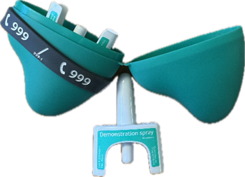
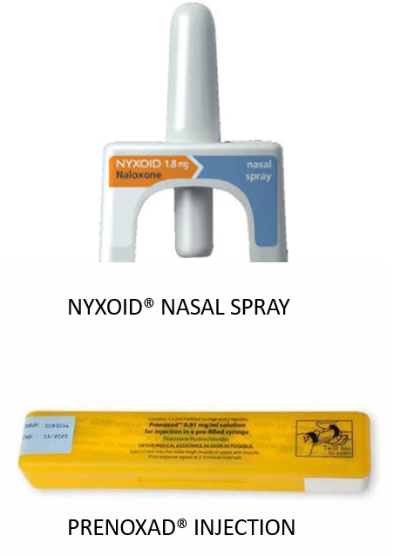
Grampian Take Home Naloxone Programme
Training for trainers

Slide 2
What will we cover today?
Know
What an overdose is and the main risk factors
Know
How to recognize a possible overdose
Know
How to respond to an overdose
Know
The different types of naloxone and how to use them
Get
You set up to administer and/or supply naloxone

Slide 3
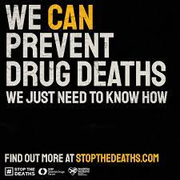
What is an Overdose?
An overdose means having more of a drug (or combination of drugs) in your body than it can cope with
The body is no longer able to function normally
Different types of drugs can produce different effects:
www.overdoseday.com/campaign-resources/
Overdose can lead to death (but doesn’t have to)

Slide 4
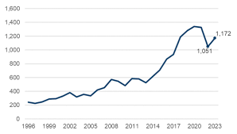
Why Naloxone?
75 people died in Grampian
21 female, 54 male
Aberdeen City :42
AberdeenShire:24
Moray 9
This number has more than doubled in the last 10 years
Drug related deaths are ACCIDENTAL and PREVENTABLE

Slide 5
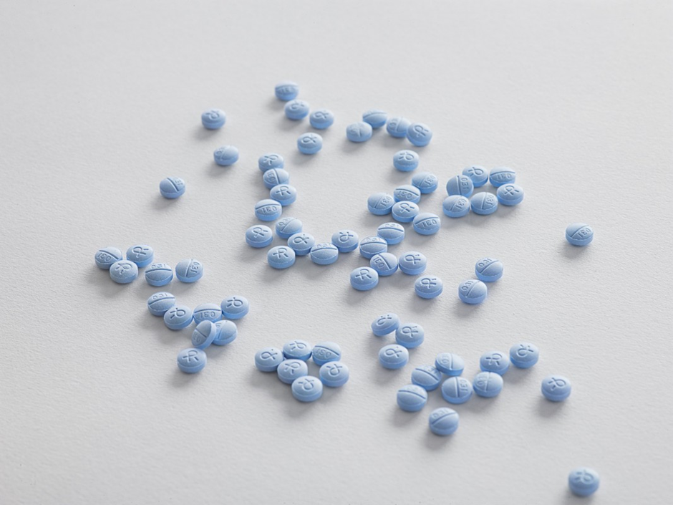
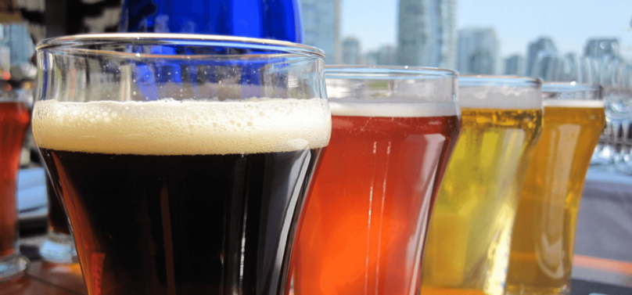
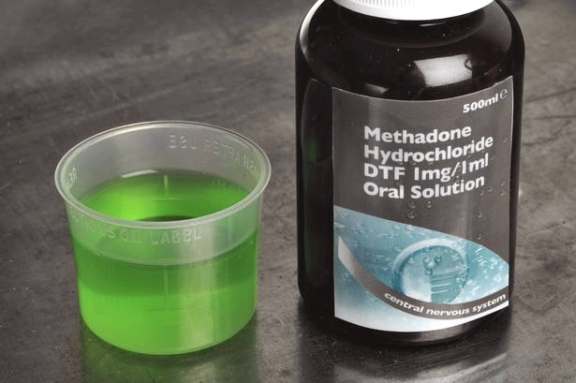
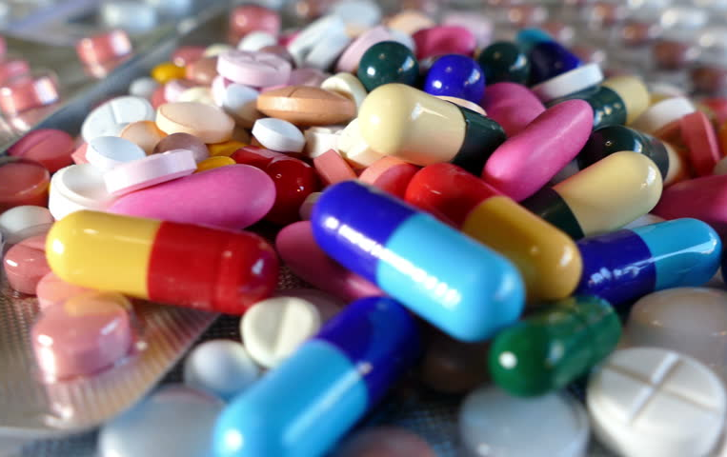
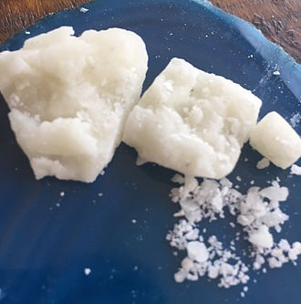
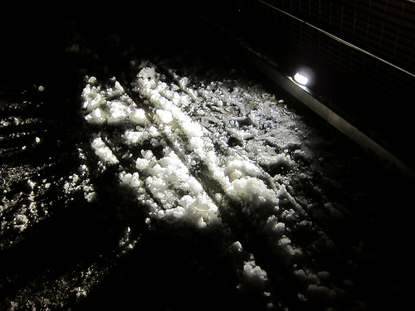
Why Naloxone?
The following substances were most commonly found in Scotland’ drug related deaths. The percentage shows the number of people who died with them in their system
BENZODIAZEPINES
41% Grampian
57% Scotland
ALCOHOL
16% Grampian
12% Scotland
OPIOIDS
77% Grampian
82% Scotland
GABAPENTINOIDS
28% Grampian
35% Scotland
COCAINE
50% Grampian
35% Scotland

Slide 6
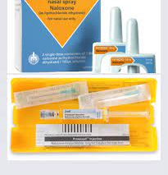
Why Naloxone?
Naloxone can reduce the effects of opioid drugs for a short time (around 30 minutes)
82% people in Scotland (77% Grampian) who died had an opioid drug present in their system
This can buy time for an ambulance to arrive
The majority of deaths occur in someone’s home
In many cases another person is present
If naloxone was available and those present able to use it, lives may have been saved

Slide 7
What factors might contribute to this?
Poverty, Inequality, Criminal Justice & Mental Health
Treatment facilities / options available
Ease of access/waiting time for treatment
Stigma & Language
Seen as a social problem, not a medical problem
Outdated Drug Policy - Misuse of Drugs Act 1971 (Focus on punishment not support)

Slide 8

What are Opioid drugs or medicines?
Opioids/opiates are a group of medications or drugs
They were developed to relieve pain and are commonly given for this reason
They can be prescribed, over the counter (from a pharmacy) or street drugs
Common examples of opioid drugs include methadone, morphine, heroin, codeine. More recently synthetic opioids - "nitazines" which can potentially be mixed with other substances

Slide 9

Discussing Drug Use
Help! I don’t feel confident discussing these different drugs”
That’s OK! You don’t need to know all the details to safely use, or give out naloxone
Naloxone can be administered even if you don’t know exactly what the person has taken. It won’t have any effect if opioids are not present
All you need to do is explain the correct course of action to take. We’ll cover this today

Slide 10
Still keen to find out more about different drugs or their overdose risks?
Scottish Drugs Forum (SDF) have eLearning including a Drug Awareness introduction as well as specific benzodiazepine and cocaine modules.
www.sdftraining.org.uk/e-learning
International Overdose Day website has fact sheets on the symptoms of overdose for different drugs in the campaign resources section
www.overdoseday.com/campaign-resources/

Slide 11
QUESTIONS ON DRUGS INVOLVED IN DRUG RELATED DEATHS?

Slide 12
Key Risk Factors in Overdose

Slide 13
Overdose Risk Factors
Knowing about overdose risk factors can help identify people at risk to make supply of naloxone to or administer it
It can also help shape discussions to make them relevant to the person
There are two key factors which will increase the risk of overdose and drug death are more likely
1) POLY-DRUG USE
2) Anything that reduces a person’s TOLERANCE to drugs

Slide 14
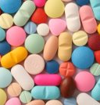
Polydrug use including alcohol
On its own, any drug with depressant effects can slow down breathing and heart rate.
If more than one is present in the body, these effects ramped up and become more dangerous.
Question: Does combining drugs always have to mean taking them at the same time………?

Slide 15
What is tolerance?
Body adapts
The body can adapt to drugs taken regularly and learn to tolerate them. Higher doses are needed to get the same effect
Break or reduction
A break or decrease in drug use for a time reduces the bodies ability to tolerate it
Overdose
The body can't cope with a return to or increase in drug use which can cause overdose

Slide 16
What is tolerance?
If a person takes more drugs than usual – even without any break - their tolerance may not be enough to cope with this
Changes in physical health and the natural process of aging can also reduce a person’s tolerance to a drug

Slide 17
Key Risk Factors
Previous near fatal overdose
Poor mental or physical health
Injecting
Homelessness and/or isolation
Using substances alone
Not in treatment or supported
Start or end of opioid replacement treatment

Slide 18
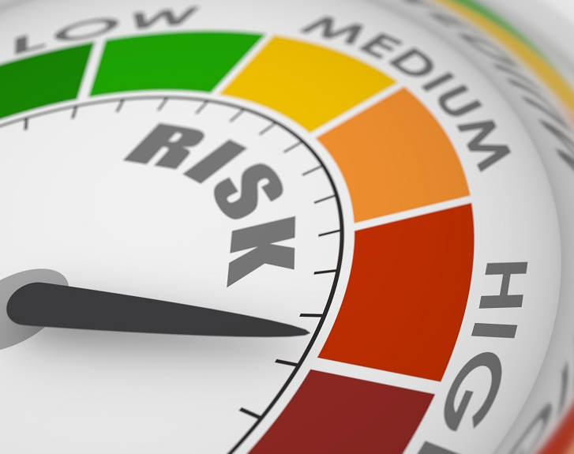
Times when overdose risk might be higher
Just left residential rehabilitation or hospital
Recent detoxification
Periods of relapse
Life events e.g. bereavement, relationship breakdown
Change in social circumstances e.g. Loss of home or job, benefits rebate
Festive periods, weekends & holidays
Release from prison

Slide 19

Consider how these might apply to people you are working with or know. Are there opportunities for naloxone supply?

Slide 20
"I walked the person around It helped them come round"
Myth Busting: What do you think?
People often have their own beliefs about what will reverse an overdose. This can be based on previous personal experience or that of someone they know.
Have you heard/can you think of any myths?
How would you respond to these if someone brings them up?

Slide 21

Myths might include....
MOVING
Walking the person around
REACTION
Inflicting pain
OPPOSITE EFFECT?
Injecting stimulant drugs
INJECTING
Injecting salty water (think saline)
WATER
Splashing with water or putting casualty in bath / shower
Were there any others?

Slide 22
Overdose: Recognising signs and symptoms

Slide 23
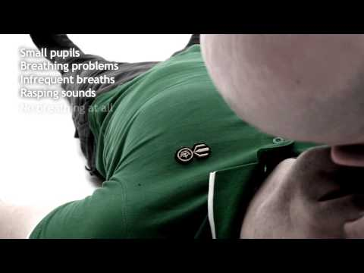
Signs of opioid overdose

Slide 24
Signs of overdose

Slide 25
KEEP IT SIMPLE If a person doesn't respond to you shaking their shoulders and calling their name, it’s time to take action

Slide 26
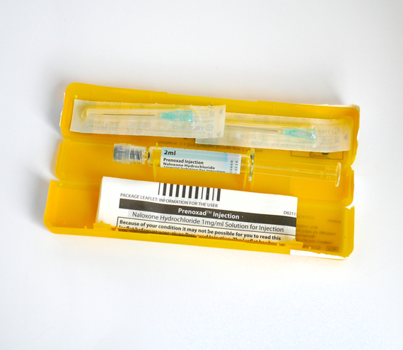
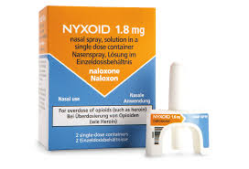
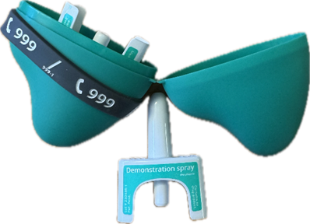
NALOXONE

Slide 27
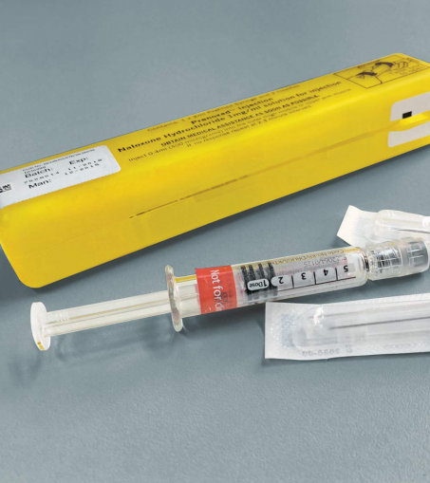
What is naloxone?
Medication which is safe and easy to use
Opioids work by attaching to opioid receptors in the brain
Naloxone knocks opioid drugs off of opioid receptors and blocks the receptor
It does not remove opioid drugs from the body
Temporarily reverses the effects of opioid drugs (30 mins)
Helps to restore consciousness and improve breathing

Slide 28
What is naloxone?
It will NOT reverse the effect of other types of drugs e.g. cocaine or diazepam
BUT - If these other drugs are present, it may remove enough of the opioid to help
Safe to administer even if you don't know what has been taken
It can buy time until an ambulance arrives – CALL AN AMBULANCE
There are no exclusions from using naloxone if overdose is suspected. Not acting may result in harm or death

Slide 29
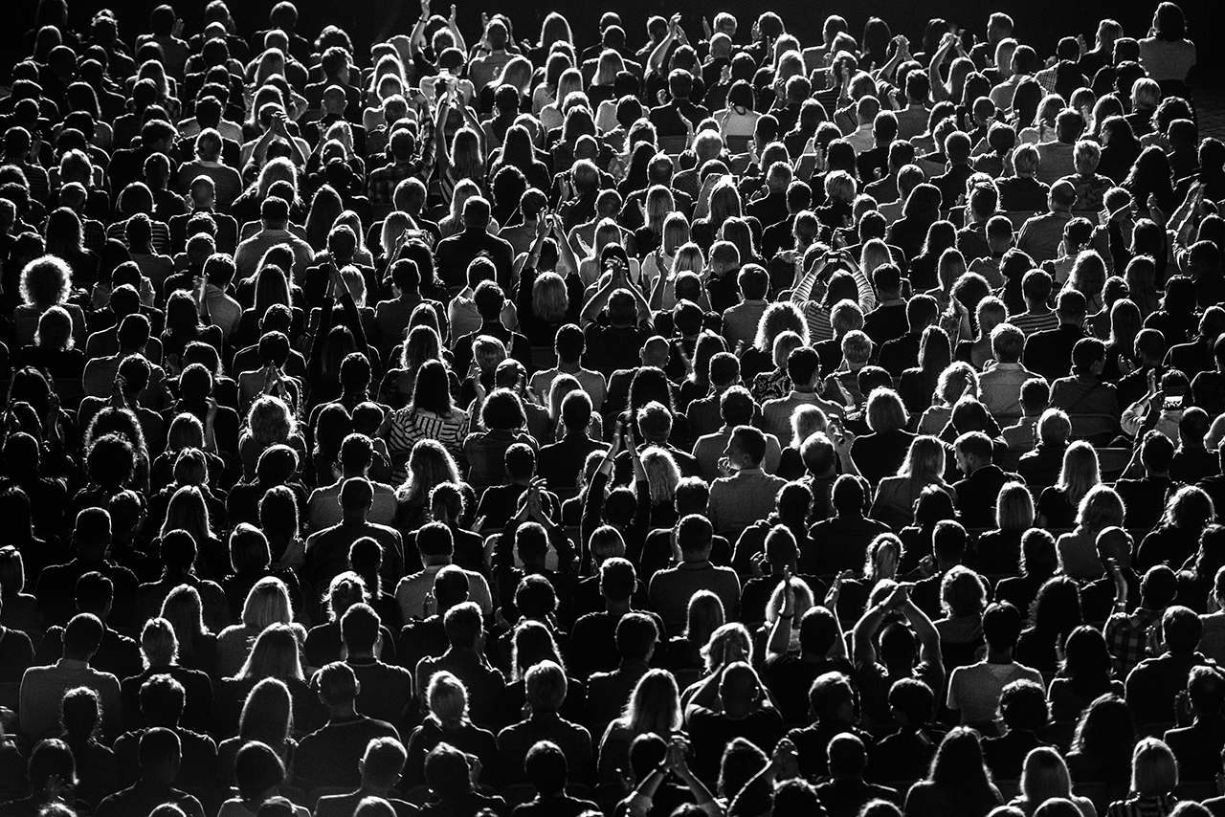
Who can use naloxone?
ANYBODY can administer naloxone for the purpose of saving a life
In Scotland we can supply naloxone to:
Anyone who is at risk of opioid overdose
Anyone who might witness an overdose. Friends, family members and close contacts
Service workers in contact with those at risk
ACTION: consider how you might identify people at risk that you have contact with

Slide 30
HOW TO ADMINISTER NALOXONE and BASIC LIFE SUPPORT

Slide 31
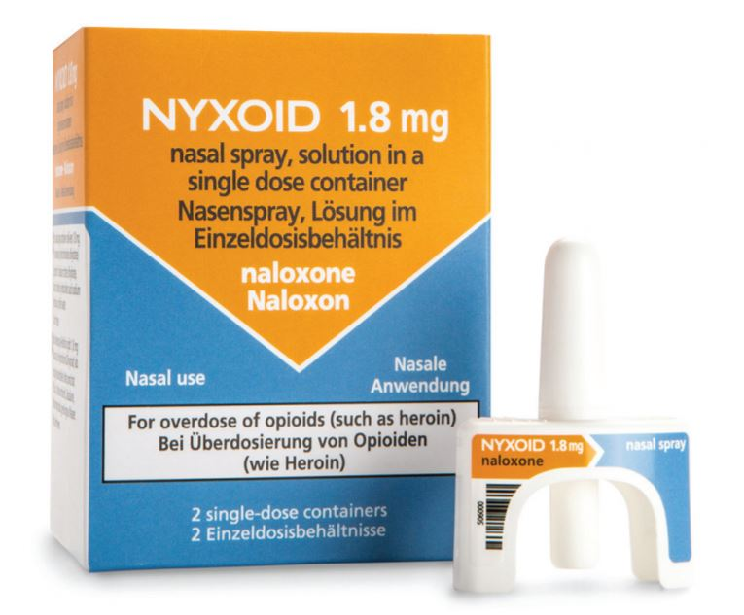
NALOXONE NASAL SPRAY "NYXOID"
Box contains TWO nasal sprays
Each spray contains ONE DOSE of naloxone (1.8mg)
Do not test - when it’s gone it’s gone!
Administer the contents of one spray into the nostril
Use the other nostril for the next dose

Slide 32
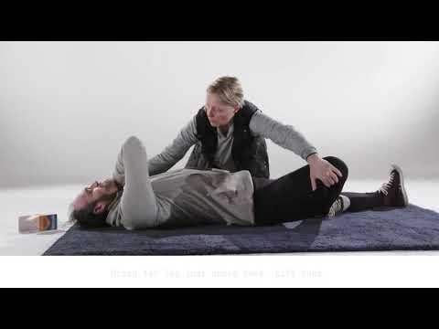
How to use Nyxoid Nasal Spray – demo or video

Slide 33
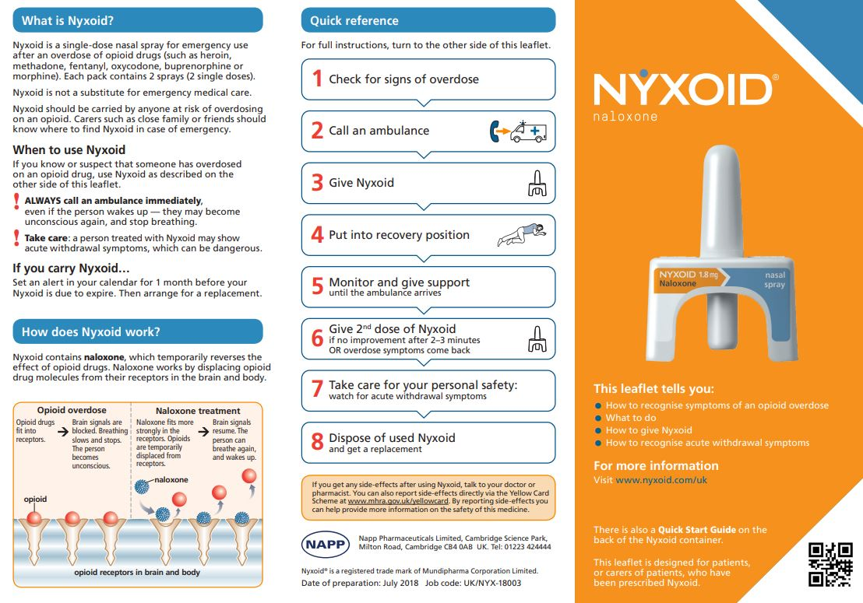
Leaflet available
www.medicines.org.uk/emc/rmm/1278/Document

Slide 34
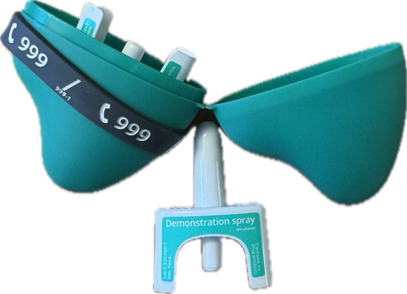
NALOXONE 1.26 MG NASAL SPRAY
•Box contains TWO nasal sprays
•Each spray contains ONE DOSE of naloxone (1.26mg)
•Do not test - when it’s gone it’s gone!
•Administer the contents of one spray into the nostril
•Use the other nostril for the next dose
•Same device as Nyxoid but case may make it easier to people to carry.
•Naloxone dose is slightly lower.

Slide 35
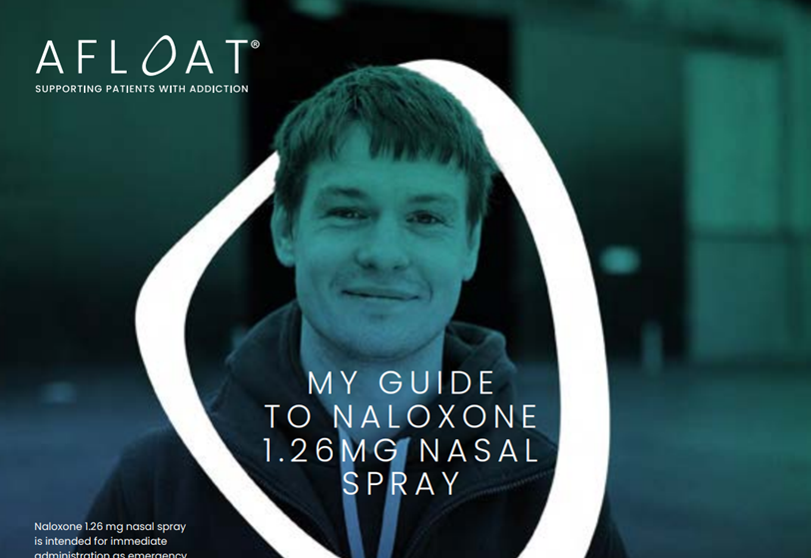
Naloxone 1.26mg nasal spray website
Prescribed Naloxone 1.26mg Nasal spray / likely to witness an opioid overdose | Naloxone United Kingdom

Slide 36
Naloxone intramuscular Injection "Prenoxad"
Box contains one pre-filled syringe with 5 x doses of naloxone (0.4mg) plus 2 needles
Must be PRENOXAD brand of naloxone - others don’t contain needles
INTO MUSCLES - Administer in thigh or upper arm muscle
Put back in yellow plastic box to dispose of / protect from needles after use

Slide 37
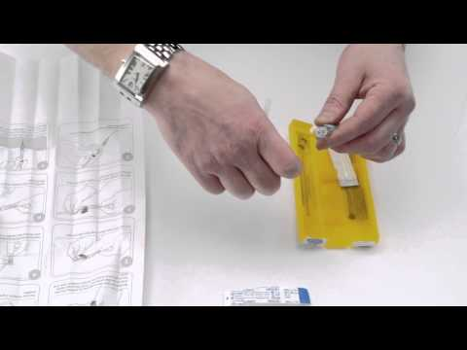
How to use Prenoxad Injection – Demo or video

Slide 38
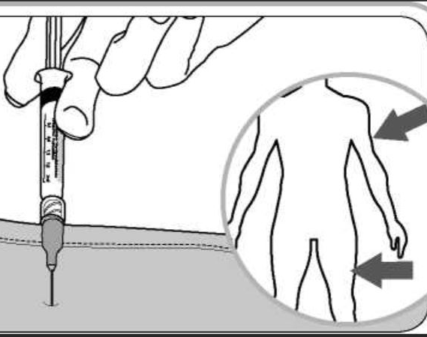
Inject into large muscle of the thigh or arm

Slide 39
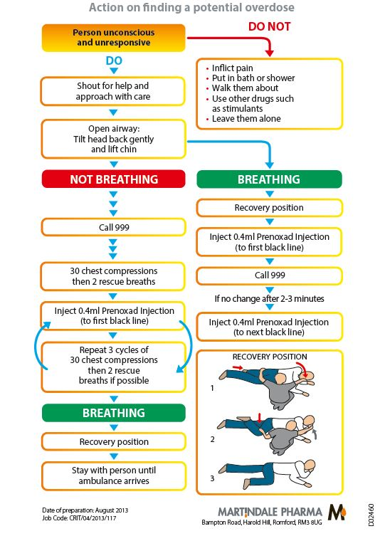
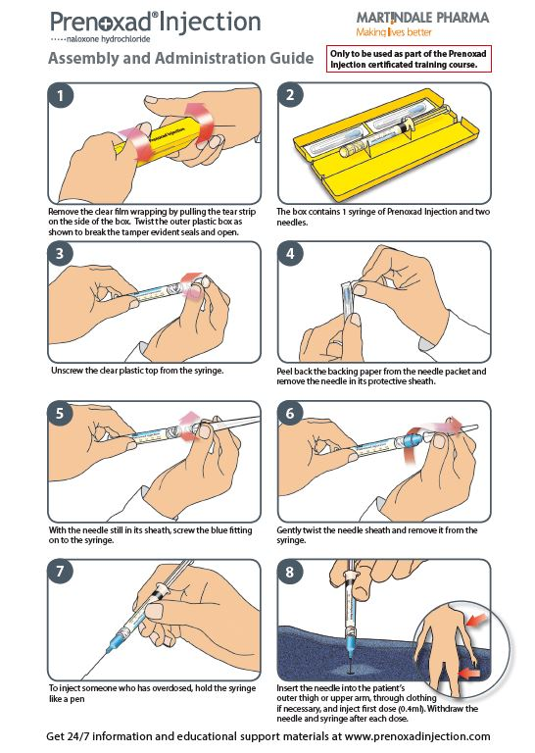
Tear off Instruction Leaflet Available
NHS Grampian resources
www.nhsghpcat.org
Other naloxone resources also available

Slide 40
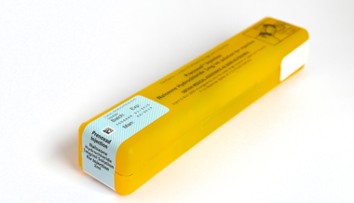
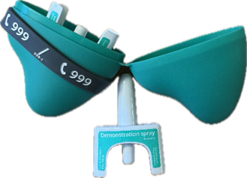
For Prenoxad, Nyxoid and Naloxone 1.26mg nasal spray....
Administer one dose every 2 – 3 minutes until...
The person responds – put in recovery position and stay with them OR
The emergency services arrive and take over OR You have no naloxone left

Slide 41
ACTIVITY
SPLIT INTO PAIRS AND TALK EACH OTHER THROUGH HOW TO USE NALOXONE – NYXOID AND PRENOXAD

Slide 42
The Recovery Position and Basic Life Support Where does naloxone fit in?
Notes:
Highlight this is not a full basic life support training course

Slide 43
IN OVERDOSE, THE PERSON WILL BE UNCONSCIOUS...
AND BREATHING = RECOVERY POSITION + NALOXONE
OR NOT BREATHING = BASIC LIFE SUPPORT (IF YOU KNOW HOW) + NALOXONE

Slide 44
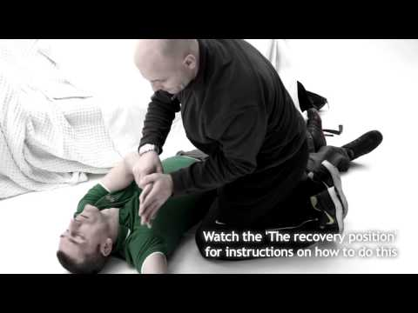
HOW TO RESPOND
PRACTICAL DEMO OR VIDEO

Slide 45
Be S.A.F.E
SHOUT for help
APPROACH with care
Ensure area is FREE from danger or potential harm
EVALUATE if safe to take action

Slide 46
CALL 999 AND ASK FOR AN AMBULANCE
Give
The location – where you are
Tell
Them the status: "unconscious" AND "breathing" OR "not breathing"
Stay
With the person until the ambulance arrives

Slide 47
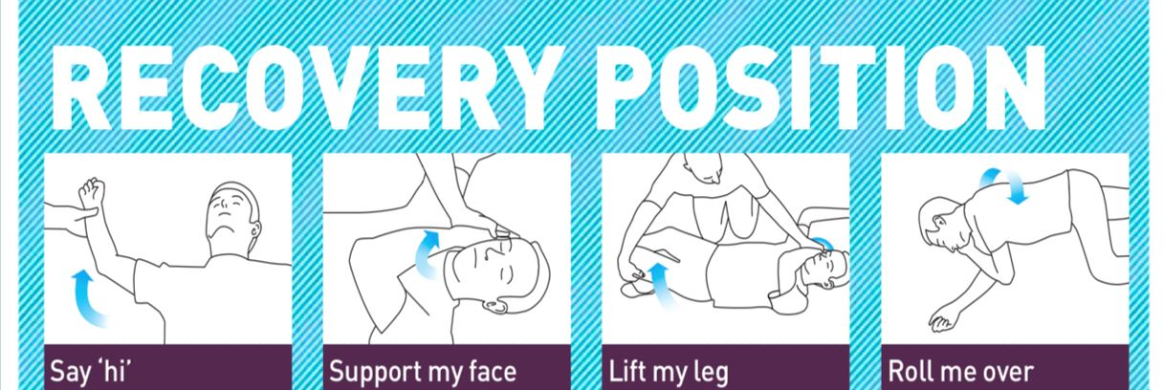
"Unconscious but breathing"
Put the person in the RECOVERY POSITION
Tilt / adjust head back make sure airway remains open
Administer naloxone every 2 to 3 minutes until person responds, ambulance arrives, or kit is finished
Check breathing regularly
Image Scottish Drugs Forum

Slide 48
"unconscious and NOT breathing"
Start basic life support (BLS) if you know how to
Aim is to keep AIRWAYS CLEAR, SUPPORT BREATHING (rescue breaths if used) and keep CIRCULATION flowing
No chest movements after observing for no more than 10 seconds? Start BLS
30 compressions followed by 2 rescue breaths (if comfortable to use)
Give naloxone every 2-3 minutes
If not sure of BLS, call an ambulance and give nalxoxone

Slide 49
DIFFERENCES SINCE COVID
INSTEAD OF PUTTING THE FACE CLOSE TO THE MOUTH TO FEEL FOR BREATH, WATCH FOR CHEST MOVEMENT
ONLY UNDERTAKE BREATHS IF COMFORTABLE TO DO SO

Slide 50
Want to learn more about basic life support?
Resus council website
Download lifesaver app
Ask about training in your workplace
www.resus.org.uk/public-resource
Look out for community training returning
Notes:
Not full BLS course etc

Slide 51
MAKING SUPPLIES OF NALOXONE

Slide 52
RECAP: WHO CAN HAVE A SUPPLY OF NALOXONE?

Slide 53
WHO CAN HAVE A SUPPLY OF NALOXONE?
Anyone who is at risk of opioid overdose (think about prescribed and non-prescribed sources)
Anyone who might witness an opioid overdose
Anyone working with people at risk

Slide 54
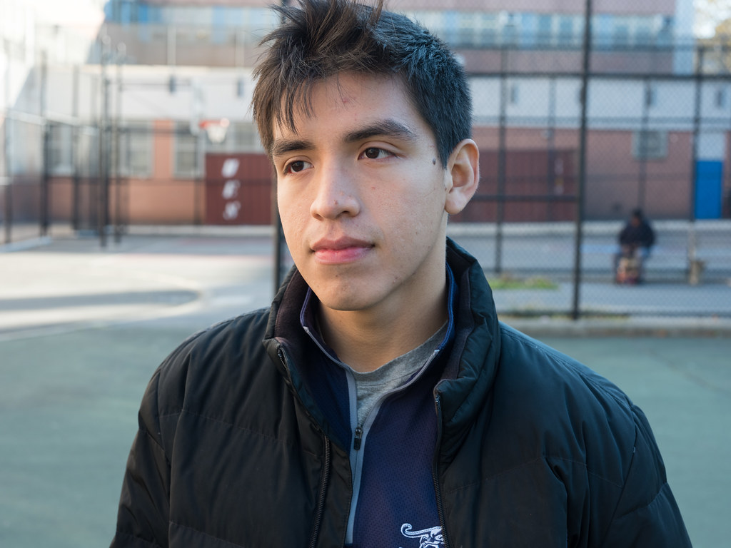
What about young people?
THEMSELVES AT RISK OF OVERDOSE OR IN CONTACT WITH SOMEONE AT RISK OF OVERDOSE
Existing GIRFEC/Child protection processes should be followed
Assess on an individual basis – should be carried out by people with experience
If unsure – contact specialist drug or young people's service

Slide 55

What about young people?
Does child have capacity to be trained and use naloxone?
Might be that training focuses on calling ambulance to get help
Are there any significant others/carers that also need training?
Weigh up risks versus benefits of all available options
Consider trauma of the young person not knowing what to do

Slide 56
Making supplies to people at risk or likely to witness overdose
BRIEF
Deliver as a brief intervention
SIMPLE
Keep it simple – focus on the key points
HAVE EVERYTHING HANDY
Naloxone kits, leaflet, Key information sheet, Recording form

Slide 57
Key points
How to identify overdose
How to respond
Call an ambulance
Basic Life Support or Recovery Position if you know how to do it
What does naloxone do?
Nyxoid, Naloxone 1.26mg nasal spray or Prenoxad?
How to use it
Give the supply

Slide 58
Q: NYXOID, PRENOXAD OR NALOXONE 1.26MG NASAL SPRAY – WHICH IS BEST?

Slide 59
Q: NYXOID, PRENOXAD OR NALOXONE 1.26MG NASAL SPRAY – WHICH IS BEST?
A: THE ONE THAT WILL BE USED!
A single dose of either should work in roughly the same time
Naloxone 1.26mg nasal spray might be easier to carry
Nyxoid might be better for
Younger people – licensed from 14 years vs 16 years for Prenoxad
People who won’t take the injectable product e.g. Don’t like injections, Family members, non-clinical service workers
People who have refused naloxone in the past
Check what the person's preference is

Slide 60
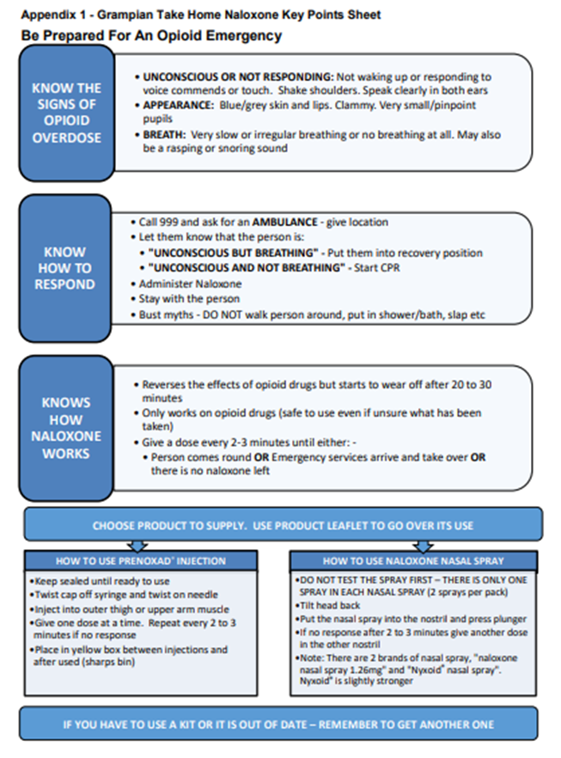
NALOXONE KEY INFORMATION SHEET
Designed to help you remember key points to use when training people
Get it here www.hi-netgrampian.scot.nhs.uk/wp-content/uploads/2020/07/Naloxone-Key-Information-Sheet-.pdf
(Google "hinet take home naloxone")
Suggestions to improve are welcome Email: gram.smspharamcists@nhs.scot

Slide 61
Recording naloxone supplies
Prescribed naloxone does not require additional recording on neo360
Entered onto neo360 - national recording system
https://scotland.neo360.systems/Secure/
Can enter directly OR note first on the "Training and Supply recording form” and submit for entry onto neo360
Ask what the process is in your service

Slide 62
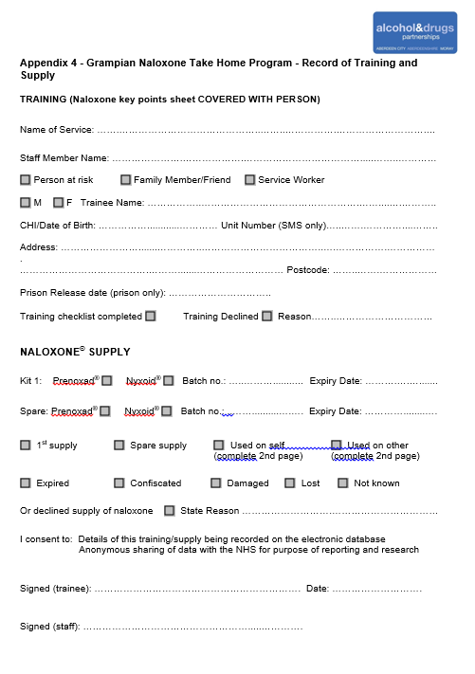
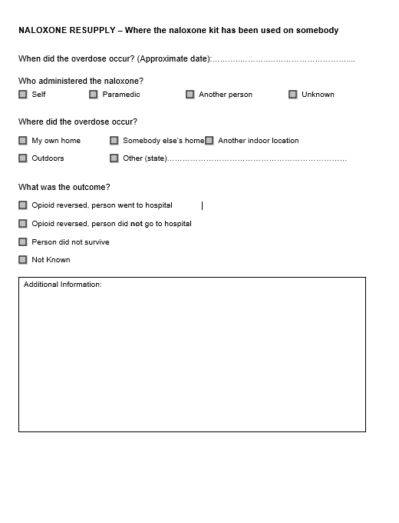
Training and Supply Recording Form
Page 1 – Complete for all supplies
Page 2 – Only complete if you are resupplying naloxone and the person has reported using it
Check with your team/service what to do with forms

Slide 63
What if someone refuses naloxone?
"I don’t like needles"
"I can’t have it in the house – what will my partner think?"
"Are you saying I’m not doing well?"
"My medicine is safe. My doctor prescribes it"
"I'm not using substances anymore"
DISCUSS OR SPLIT INTO YOUR GROUPS / PAIRS
THINK ABOUT HOW YOU MIGHT RESPOND
ARE THERE ANY OTHER BARRIERS YOU CAN THINK OF?

Slide 64
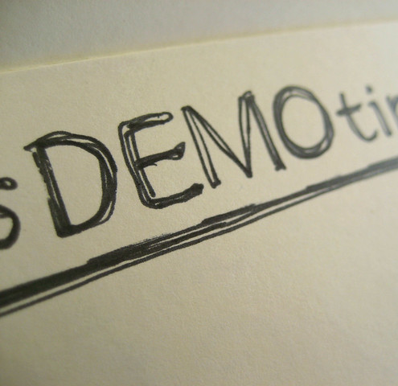
Demonstration of naloxone brief intervention
Example of naloxone intervention
Split into groups or pairs and practice giving naloxone to them

Slide 65
GETTING STARTED

Slide 66

TEAM OR SERVICE ALREADY GIVING OUT NALOXONE?
Read NHSG guidance document (PGD for NHS staff not working in a drug treatment service)
All documents can be found by Googling "HINET TAKE HOME NALOXONE" or going to
www.hi-netgrampian.scot.nhs.uk/naloxone/
When you are confident you are ready to go, speak to your team lead or service manager
Let them know you are trained and ready to go
They will talk you through how it works there
If your team is not set up, ask your manager to get in touch with naloxone training lead

Slide 67
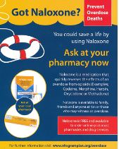
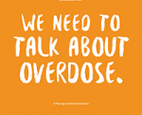
Resources
Head to the "Hinet take home naloxone site" for guidance, videos and support
Leaflets can be ordered from www.nhsghpcat.org
Overdose day fact sheet www.overdoseday.com

Slide 68
All the links
Grampian Take Home Naloxone Page (professionals): www.hi-netgrampian.scot.nhs.uk/naloxone/
Grampian Public Facing Overdose Page: www.hi-netgrampian.scot.nhs.uk/overdose/naloxone/
SDF elearning module: www.sdftraining.org.uk/e-learning
Overview of changes in naloxone legislation (PHE, 2015) www.gov.uk/government/publications/widening-the-availability-of-naloxone/widening-the-availability-of-naloxone
Public Health England (PHE), Health Matters Tool/Website https://publichealthmatters.blog.gov.uk/2017/03/01/health-matters-preventing-drug-misuse-deaths/
Care Inspectorate - Health Guidance: Take Home Naloxone in Social Care Services: www.careinspectorate.com/images/documents/3203/Take%20Home%20Naloxone%20in%20Social%20Care%20Services.pdf
International Overdose Awareness Day Website: www.overdoseday.com/
Nyxoid leaflet: www.medicines.org.uk/emc/rmm/1278/Document
Prenoxad leaflets, booklets etc: www.medicines.org.uk/emc/product/3054/rmms
Nalxone 1.26mg nasal spray leaflets: Prescribed Naloxone 1.26mg Nasal spray / likely to witness an opioid overdose | Naloxone United Kingdom

Slide 69
Questions End of session for staff making supplies or administering naloxone

Slide 70
NEW SERVICE OR TEAM? Information for service managers or team leads

Slide 71
All of Grampian's drug treatment services and community pharmacies delivering ORT are already set up to supply naloxone Email gram.smspharmacists@nhs.scot if you need any information

Slide 72
NHS staff NOT working in drug treatment services
Prenoxad, naloxone 1.26mg nasal spray and Nyxoid can be prescribed e.g. as part of discharge process, or supplied by using a PGD
After training, staff should read the PGD and confirm they are happy with the content as per usual procedures
Over-labelled stock is available from ARI pharmacy and can be added to ward order lists

Slide 73
Staff working for other non-clinical services
The Lord Advocate issued a statement of prosecution allowing non-clinical organisations in Scotland, which are not a drug treatment service, to supply naloxone as part of Covid measures
These currently remain in place awaiting conclusion of a UK government consultation to amend national legislation to allow this
Services not classed as drug treatment services must be registered with the Scottish Government – Naloxone leads will add you to this list when you are good to go
The Care Inspectorate has guidance which informs service on best practice (NB: has not been updated with information about Lord Advocate changes or addition of Nyxoid)

Slide 74
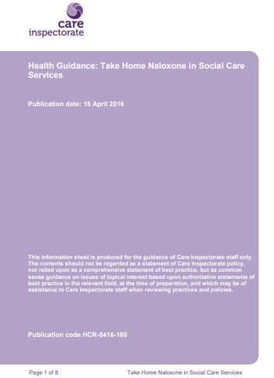
Staff working for non-clinical services
All services should have a protocol which: -
Lets staff know how naloxone works in their team or organisation
Has a process for recording who is trained to administer and/or supply naloxone
...and a process for ordering, storing, date checking and rotating naloxone kits.
includes information on what to do if the kit is used or passes its expiry date
Has information on how to record naloxone supply if not prescribed
Naloxone leads will support you to get set up for ordering and recording naloxone supplies on neo360.

Slide 75

Questions?

