Slide 1

Stress and Distress in Dementia
Alison Reddish, Principal Clinical Psychologist
Stefanie Scott, Clinical Associate in Applied Psychology
Angela Pointon, Specialist Occupational Therapist and CPCS Lead for NHSG
Notes:
Good afternoon and welcome to the fifth in our series of AHP dementia webinars. This topic was requested by attendees of pervious webinars and I am grateful to Alison and Stefanie for agreeing to facilitate this session. Alison is the principal clinical psychologist and Stefanie is a clinical associate in applied psychology, both working within the Older Adult Mental Health service based at Cornhill hospital.

Slide 2
Housekeeping
Cameras off
Mics muted
Time for questions at the end
Webinar and recording will start at 12:00
Notes:
Teams has automatically turned off your cameras and mics. However, you can ask any questions either in the chat box or the Q&A section on the top banner. I will keep an eye on the chat as we go along.
The recording will be shared in the chat after the session and also uploaded on to our Hi-net page. The link for this will be in the chat and you will also find the previous 3 webinars there in case you missed them.

Slide 3
Background
Stress and distress behaviours are common in dementia
Estimated 40% of acute beds occupied by someone living with dementia
AHP's are likely to meet individuals experiencing stress and distress in a range of settings
Notes:
Before I hand over to Alison and Stefanie, I wanted to give some professional context for the session.
Stress and distress behaviours are common in dementia, although not everyone will experience them. They can be, by their nature, stressful and distressing both to the person and those around them, including loved ones, carers and staff.
At any one time, it is estimated that 40% of beds in an acute hospital are occupied by someone living with dementia. Hospital and care home admissions can be very stressful for people living with dementia. The environment is busy and unfamiliar, the person is not able to follow their usual routine and use their own coping strategies on top of potentially feeling physically unwell. As a result, hospital admissions are a potential trigger for stress and distress behaviours. However, these behaviours can also occur within the home environment so, as AHP's, we are likely to meet someone who is experiencing stress and distress.

Slide 4
Scotland's Dementia Strategy – Everyone's Story
  Identification and management of the symptoms of stress and distress across care settings
  Non-pharmacological interventions may improve cognition, social engagement and quality of life and decrease stress and distress.
  Recognises hospital admissions as a trigger for increased stress and distress. Aim to enhance community supports to prevent admissions and support discharges to home
Notes:
Scotland's dementia strategy highlights the importance of identifying and managing symptoms within all care settings.
It specifically mentions non-pharmacological interventions such as exercise, engagement in tailored activities, communication strategies and music therapy as ways to improve quality of life and decrease distressing symptoms.
As we have already mentioned, hospital admissions can be a trigger. The long-term aim is to increase community support, such as hospital at home and community rehabilitation, to minimise admissions to hospital and facilitate early discharge.

Slide 5
SIGN 168 - Assessment, diagnosis, care and support for people with dementia and their carers
  "All healthcare professionals working with people with dementia need to assume responsibility for detection and treatment"
  "Outdoor activities, massage and touch therapy, and exercise, were effective in reducing aggression and agitation, verbal aggression and physical agitation when compared to pharmacological treatments"
  Tailored activities
Notes:
The SIGN guidelines highlight the role of all professionals in detecting and treating stress and distress in dementia.
Specific interventions such as outdoor activities, massage, exercise and tailored activities are named as recommendations.
Tailored activities are those which have been identified as being meaningful to the person with attention paid to how to grade and adapt these to match the abilities of the person.

Slide 6
AHP roles in reducing stress and distress
Physical movement
Reducing pain and fatigue
Facilitate and maximise communication
Improve nutritional intake
Treatments for anxiety and depression
Environmental modifications
Maintain independence
Meaningful activities
Notes:
AHPs, like physiotherapists and occupational therapists, can address physical health issues that may contribute to stress, such as pain, fatigue, and mobility limitations. We can recommend interventions like exercise, diet, and assistive devices to improve physical well-being.
Speech and Language Therapists can play a vital role in improving communication between individuals with dementia and their caregivers. This can involve training caregivers on effective communication strategies, like using short, simple sentences and nonverbal cues. They may also do life story work as part of a communication aid.
Dietitians and speech and language therapy have roles in maximising nutritional intake to improve physical health and wellbeing and impact mood and brain health.
OT's can offer treatment to address anxiety, depression, and other emotional distress where appropriate. This may include considering an individuals routine and activities and introducing opportunities for them to engage in meaningful occupations. They can also assist in creating a supportive and safe environment for individuals with dementia. This may involve adapting the home or care setting to promote independence, improve navigation, and reduce sensory overload. It may also involve recommending technology which may support the person.
AHPs can provide support and resources to families and caregivers, helping them cope with the challenges of dementia and promoting their own well-being.

Slide 7
What is Stress and Distress in Dementia?
'Any behaviour, including apathy, that causes emotional distress within the person with dementia, their carer or others in the environment.'
                (MacKenzie & James 2011)
For all of us our behaviour has a purpose. This could be to express our feelings, wants or needs; to try to directly meet our needs; or to communicate frustration when our needs are not met.
As dementia progresses, people may have difficulty meeting, communicating and expressing their own wants and needs. When this happens, this can result in distress for the person and/or others around them. We call this 'stress and distress'.
Notes:
Alison
2 mins
- Read slide – note that S&D isn't an inevitable part of dementia and won't be experienced by all, but it can be a difficult experience for the person and/or those around them when it does occur

Slide 8
What does Stress and Distress in Dementia look like?
Verbal or physical aggression
Pacing
Appearing scared or anxious
Crying, shouting, screaming
Hoarding or hiding objects
Appearing low in mood
Touching others
Night-time waking
And many other behaviours...
Withdrawing from activities/other people
Attempting to leave wards/care homes
Suspiciousness
Searching for deceased family members
Disorientation to time and place
Refusing assistance with tasks of daily living
Notes:
Alison
2 mins
As many will be aware S&D can cover a wide range of behaviours, some of which are listed here, we’ll often find that some S&D may be distressing for the person themselves, some more for the people around them and some for both. This is not a complete list, but some common experiences that we often see. Sometimes distress that is less obvious, such as withdrawing can be a bit more tricky to see straight away and can be missed especially in busy clinical environments

Slide 9
Understanding Stress & Distress:
what’s going on under the surface?
What we see…
Trying to leave the ward or care home
What we don’t see…
Notes:
Alison
3 mins
You have likely come across the Iceberg analogy used at other times – it can also be very helpful for better understanding stress and distress.
It can help us to think about potential underlying causes of distress and better understand our patients experiences. It's really important that we try to understand the cause or factors contributing to the behavior, as this can help us to not only alleviate distress, but also be proactive in preventing it from occurring.
As we can see from this diagram, the distressed behaviour is just the 'tip of the iceberg'. We can see on the surface the behaviour and the environment around someone, but like an iceberg, there is a lot more going on below the surface that we don’t see straight away, without knowing more about the people we work with. These are potential causes of distress that may not be visible to us initially, but are having an impact on the person and their behaviour. We can see that the majority of these contributing factors are below the surface and this Iceberg model is a way to help us think about what might be causing distress for someone.
Here we can see an example of someone trying to leave a ward- under the surface we can see much more about their experiences: premorbid personality - hard worker– perceptual difficulties visual impairment that impact their understanding of the environment in the ward. 'BELIEFS‘ believing that they are 28 years old and on waking up they need to get to the early shift at work, otherwise they won’t get paid. This highlights a really important concept to keep in mind in working with distressed patients - the role of beliefs in making sense of the world and the impact of ‘altered reality’ in dementia. Dementia can be a bit like a time machine for many people, where as memory becomes impaired and more recent memory is lost, people shift back to an earlier point in their lives rather than the here and now as we know it. This changes their reality which becomes altered and so their beliefs may not line up with what we know to be true, for example, believing they are 28, still need to go to work or need to pick up young children from school rather than being 87 and in hospital for rehab following hip surgery. These beliefs can then impact how that person makes sense of the world around them and therefore how they will behave. In these circumstances if this is what they currently believe and how they make sense of the world, we can see why this would lead to distress in the here and now and that trying to re-orientate them to our reality, will likely not be helpful. Instead we may wish to try to get alongside them and enter their world. NES have a very helpful animation on TURAS - Understanding altered reality in dementia | Turas | Learn.

Slide 10
What causes Stress and Distress?
Biological
Type of dementia
Physical illness
Experiencing pain
Dehydrated / hungry
Constipation
Infection
Delirium
Sensory impairments
Psychological
Anxiety
Mental health difficulties
Past trauma
Loneliness
Low mood
Missing family or pets
Altered sense of reality: e.g. believing they are younger than they are
Social & environmental
Disorientation in unfamiliar environment
Being too hot or cold
Wearing uncomfortable clothes
Too much stimuli: e.g. light or noise
Misidentifying people
Notes:
Stef
5 mins
The biopsychosocial model can help us to consider what are some potential causes of stress and distress. We can think of this as the part of the iceberg that is under the water. These could be specific triggers to distress day to day, or underlying factors that are contributing to distress over time
These could be things that are biological or medical in nature – read out examples. Or they could be social or environmental – read out examples.
There could also be psychological causes of distress – read out examples. Psychological factors include thoughts, feelings and behaviours. For example if we think we are at risk of harm or danger, we may feel anxious or scared and we may attempt to seek safety or comfort from others
You can see from the diagram that each of these areas will overlap with and influence each other. The helpful thing about using this way of thinking about distress is that many of these things are changeable or we can influence them and if we can figure out these causes we can try and help improve/reduce them. For those that can’t be changed, understanding how they may be contributing to distress can allow us to adjust our practice and approach to take these factors into consideration. For yourselves as AHPs, keeping an eye out for these and understanding these causes of distress may help with suggestions you can give to the care team to help make changes/treatment that could reduce barriers to assessment and treatment e.g. treating pain, or infection or may be adjustments that you can make or suggest the team makes for working with someone longer term e.g. environmental adjustments,

Slide 11
Psychological causes of distress – unmet needs
Comfort
Attachment
Identity
Person
Inclusion
Occupation
(from Kitwood, 1997)
Notes:
Stef
2 mins
We all have psychological needs, and these are no different for people with dementia.
Some examples of psychological needs identified as common for people with dementia from Tom Kitwood's work are: click to reveal on screen - Attachment ; Comfort ; Identity ; Occupation ; Inclusion
If these needs go unmet this can lead to feelings of insecurity, frustration, boredom, lack of purpose and sense of self, isolation, anxiety, low mood, etc and can lead to stress and distress.

Slide 12

A stepped care approach
Reducing Stress and Distress in Dementia
Step one
Rule out and treat any biological causes of distress (think pain, infection, dehydration, impact of underlying health condition etc) – or if not directly involved in treatment flag this to the care team involved, so they can further assess and treat
Step Two
Consider social/environmental and psychological causes of distress and any direct changes that can be made to modify these
Step Three
Consider referring on for specialist input for assessing stress and distress.
Consider wider use of proactive and preventative strategies to reduce distress and suggestions related to these that could be made to care team
In keeping with AHP roles highlighted earlier in presentation & possible biopsychosocial causes of S&D:
what this looks like will depend on area/service you work within. For those working in community or OA dementia wards referrals can be made to specialist OA services for assessment and intervention of distress – Psychological interventions for distress available via referral to OA CMHTs or for dementia wards direct to OA Psychology service. Within OAMHS there is a further stepped care approach before CMHTS would refer for Psychological Intervention. If you are based in an acute hospital then assistance and assessment of distress would be via OA liaison.
Notes:
Alison
3mins
Read Slide.
Step one, two and three.
Look for signs of distress and clues of unmet needs or any signs of different underlying cause of distress
Signs of biological causes of distress: avoiding physical contact, physical distress like ‘protecting an area’ in terms of pain, taking off clothes, acute changes in presentation or deterioration that is very acute in nature…Can we ensure that possible biological causes of distress have been considered when we observe distress…e.g. untreated pain? Dehydration? Use the wider system around us to assess this e.g. GP/systems within acute wards
Elaborate if time on step three: When we receive a Newcastle model referral, we use psychological models to consider what may be the causes of distress and what the patient's needs may be this is a team based approach used within OAMH services (IP & community)

Slide 13
Reducing Stress and Distress in Dementia
General strategies to keep in mind when working with S&D
Think Biopsychosocial causes of distress
Remember to explore who the person is beyond their dementia → what’s under the water in the iceberg model
Validate emotional experiences and enter the persons world
Use of communication strategies
Meaningful activity to meet needs
Use of routines
Notes:
Alison
5 mins
As we mentioned earlier, due to the range of professionals and settings of those attending today and the time we have, we can’t go into lots of detail on specific strategies to reduce distress, however we can briefly think about general strategies that can be helpful to keep in mind. These would be in keeping with working in a proactive and preventative way to allow earlier intervention and/or reduction of distress. We would also hope that by working with these approaches in mind we may be better placed to stop distress from escalating, when responding to distressed patients. There isn’t a one size fits all to this and it will depend on patients needs and the setting we’re in. As part of working proactively we’re trying to better understand what may be causing or triggering distress and look for any clues from the person we’re working with to this such as their facial expression, what they say, triggers we observe etc.
some of these general approaches to keep in mind in relation to stress and distress are:
Use of the biopsychosocial model to help us identify what could be causing distress and from this think about anything we can change or recommendations we can make to care teams to modify these factors
Continuing to think about the person beyond their dementia to help us put ourselves in their shoes. Using the Iceberg model is key to this. This can involve trying to get to know our patients as much as we can, as time allows– so we can understand what may be under the surface. This could mean talking to POA prior to meeting patient, learning what we can about previous preferences and routines, so that we can consider that when assessing and engaging with our patients. Trying to find out more from notes and getting to know me document. Speaking to the care team in advance to see if they have observed any distress and any approaches they've identified that work well that you can use when assessing and engaging the patient or any clues these approaches give us to better understand causes of distress
Validating and entering the persons world: thinking about the idea of altered reality and ‘stepping into their shoes’ when possible. So avoid getting into arguments with the person if their beliefs are different from ours and generally don’t try to reorientate them to our reality. Instead validate their experience by acknowledging how they feel (e.g., I can see that you are scared right now or I know you miss your mum etc) and try to meet them where they are. In doing this we’re communicating that we empathise with their emotional experiences, which can help people feel understood at difficult times, rather than us reorienting our patients to our reality – that can lead to them feeling unheard, feelings of mistrust/suspicion and escalating distress
Communication
Consider how can we adjust our communication or recommendations we can make to care teams about changes to communication to maximise opportunities for communication, increase patients understanding and reduce misunderstandings/misinterpretations– looking for any barriers to communication impacting assessment and care?
Learning what we can about communication needs from the staff before meeting patient, e.g. any sensory impairments and what they are, what the staff have observed in terms of patient's understanding and what they appear able to communicate - so we have a sense of what approach we can take. Of course, we don’t want to assume people can’t understand us, however if we adjust our communication to be clearer and provide more time for processing speed then we can ensure best opportunities for communication
Thinking about our basic steps to maximise communication: ensure hearing aids / glasses etc. are on and correct prescriptions, use clear language and reduce distractions or background noise where possible (turn off TV / radio)
e.g. leave a longer pause between sentences, use pictures and other prompts when talking, give less information all at once
Meaningful activity: How can we tie this in with psychological needs that we considered earlier - and adjust this to current environment or adjust in line with someone's current level of functioning that meets their needs. what does the person like doing/have they liked doing? Are there activities they can assist with to give a sense of purpose occupation, identity, attachment and connection with others etc
e.g., folding towels, assisting with the dishes? e.g. gardening group, football memories groups, walking, audio books
Finally as much as possible create a safe and predictable environment via use of routines – this can help the world feel more predictable and help people feel more in control - this can be something you're directly involved with or it could be part of recommendations that help the care team proactively meet patient needs
e.g., going to bed / waking up at similar times each day, regular meal times, e.g. timing of meals, particular activities at the same time each week, same time going to be
These strategies can either be adapted into our ways of working when carrying out assessments or attempting to directly engaging someone in treatment where distress can be a barrier to engaging in that work. Or these can be suggestions we consider implementing and using to form recommendations for the direct care team to trial in their support of the patient. These would tie into the role of AHPs that Angela mentioned earlier, where there may be roles in proactively preventing distress that AHP assessment and treatment can play a direct part in, for example assessments relating to activity and communication. More widely keeping in mind the models we’ve discussed today, can help us to think about where our intervention may be particularly pertinent in meeting needs and proactively reducing distress. If we can better understand possible causes of distress we can either try to change these or adjust our approach to an assessment to take these factors into account
If the person has become highly distressed, these strategies may not be appropriate to use – instead, focus on giving the person some space and time to recover (again – put yourself in their shoes – if you are angry or upset, what do you want?) is there a better time to return & meet pt again, what clues did we see from their distress that may help us understand their experience (what they said/did/facial expressions)

Slide 14
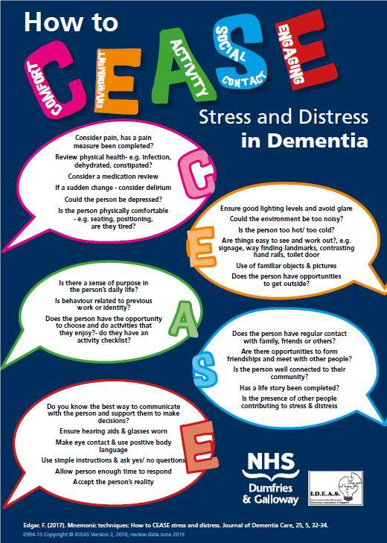
Reference: IDEAS Team, NHS D&G
Notes:
Alison
Here's a helpful checklist produced by NHS Dumfries & Galloway as a reminder of factors to keep in mind when working with stress and distress that cover some of those factors and more Comfort, Environment, Activity, Social Contact, Engaging – really useful prompts around each area and a helpful resource to use

Slide 15
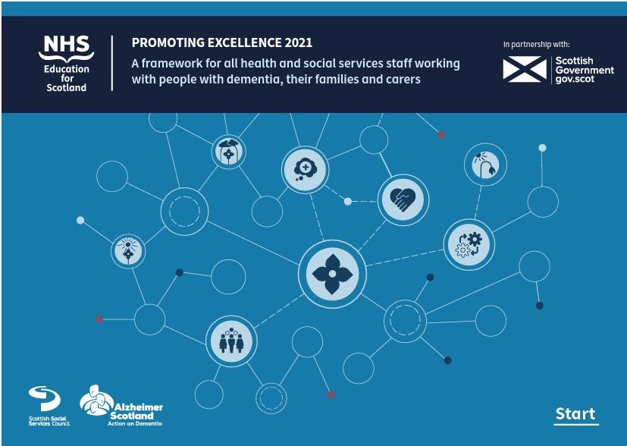
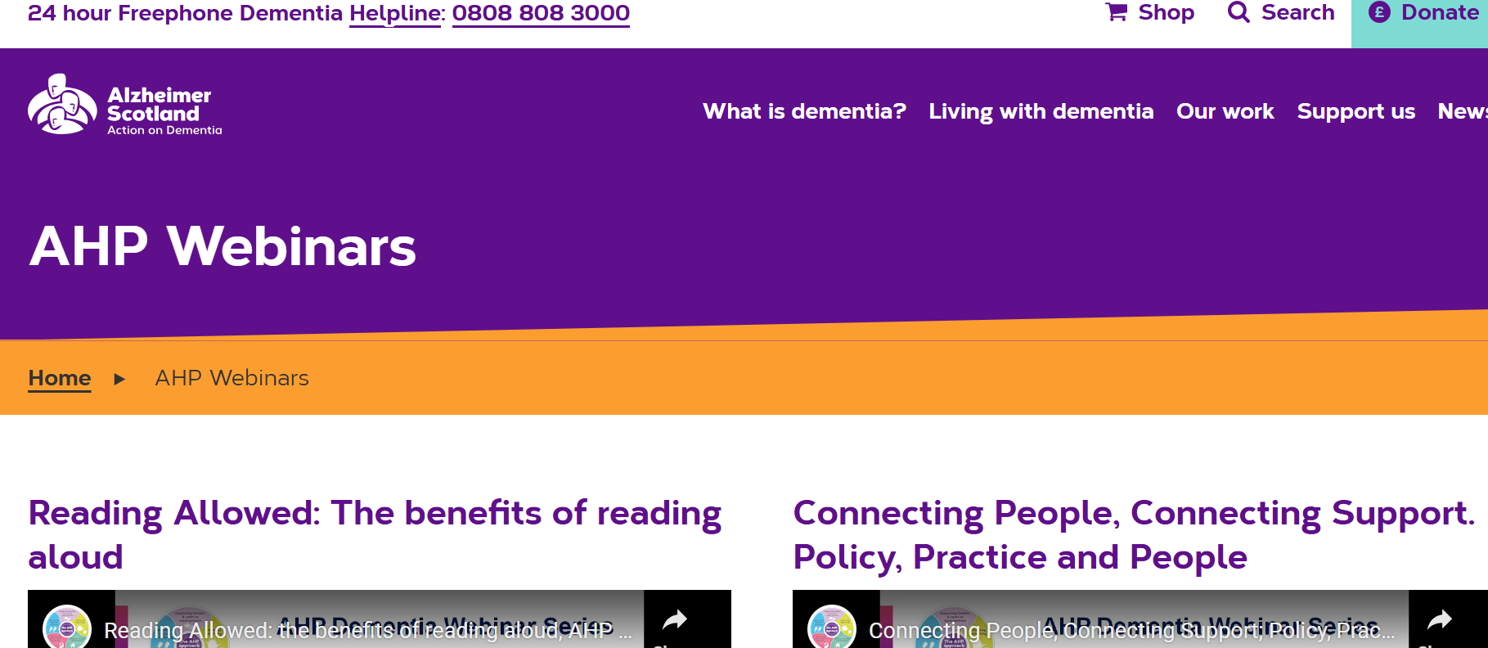
Further Training
NES & Scottish Government 'Promoting Excellence Framework’
We don’t all need to have the same training, but we should all have some, as people with dementia will access many parts of the health & social care system
NES has a range of training resources on TURAS for both acute and community based staff based on above framework
Alzheimer Scotland has a range of AHP webinars across relevant topics https://www.alzscot.org/ahpwebinars
Notes:
Stef
2 mins
Read below:
NES & Scottish Government launched the 'Promoting Excellence Framework' in 2011 updated in 2021 this details the levels of training that all of us in H&SC should have relating to dementia
We don’t all need to have the same training, but we should all have some as people with dementia could access many parts of the health & social care system, not only dementia services/services for older people
NES has a range of training resources for those who don't work in older adult/dementia services on TURAS – at the 'informed' level and skilled level. Including modules specifically for those in acute hospital settings, for paramedics and a module on delirium. Anyone in H&SC can register for TURAS to access these not only NHS staff
If we work in specialist services for older people/for people with dementia we should access additional training, depending on our role, some of this is on TURAS and some is provided through OA Psychology Dept & other H&SC trainers – your team lead should know about this, so please ask them if you're unsure
Alzheimer Scotland also has a range of AHP specific webinars that are related to many relevant topics in terms of reducing distress by proactively meeting needs, how practice can be adapted for use in dementia care, exercise programmes, occupation and cognitive impairment in acute hospital setting, music therapy, connecting carers to support communication – many of these would be on topics that would be really useful in terms of meeting proactive needs around distress

Slide 16
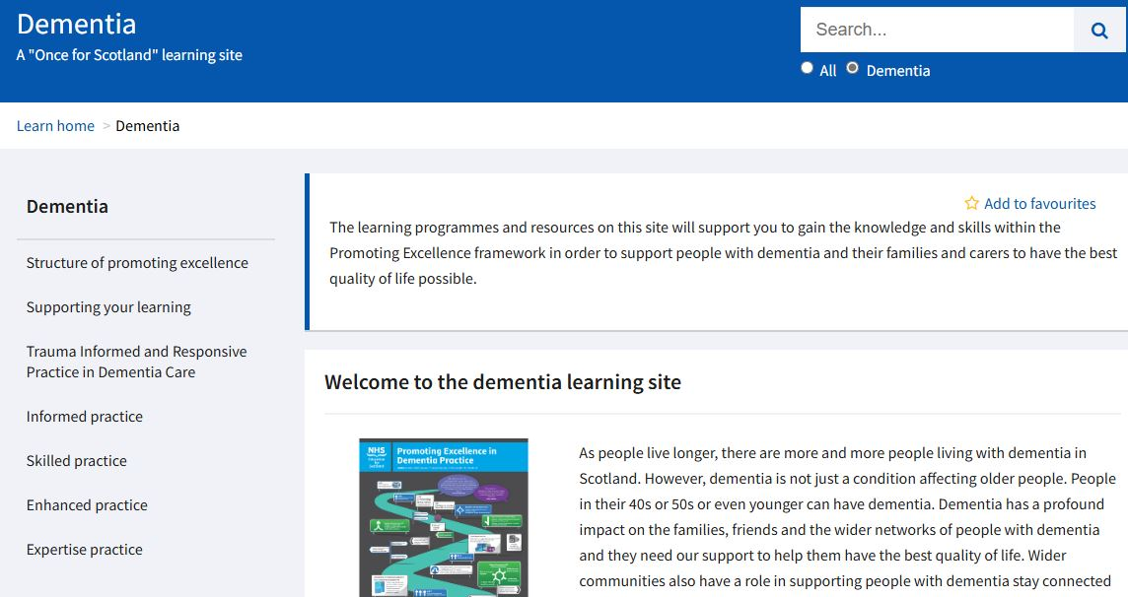
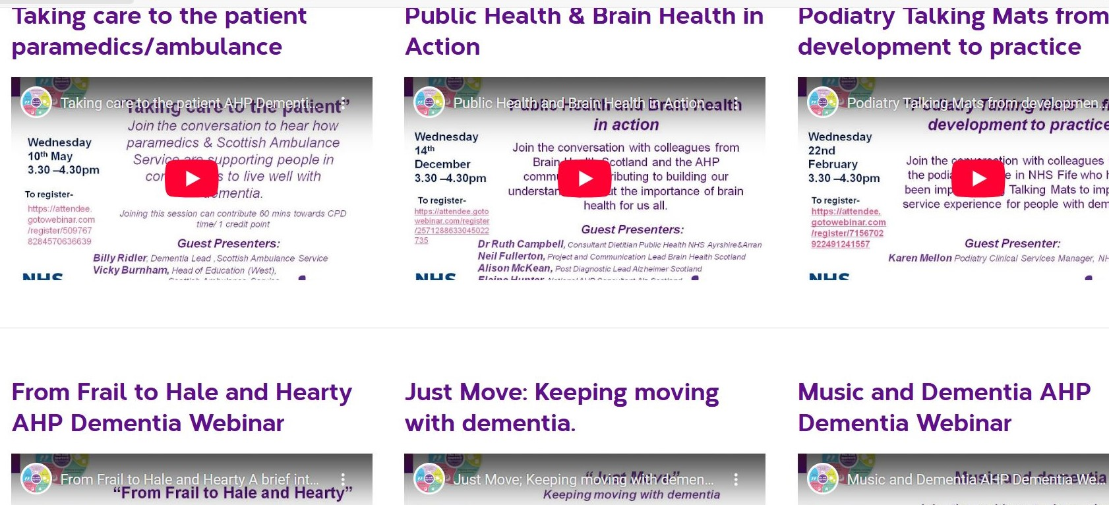
Further Stress & Distress Training
Informed practice training resources – series of short videos (for all staff in H&SC) Learning Resources | Turas | Learn (nhs.scot) NES TURAS
Stress & Distress elearning module
Dementia | Turas | Learn
Supporting people with dementia in Acute Care Modules - NES TURAS
Scottish Ambulance service Dementia Learning NES Resource TURAS
Delirium NES module & AHP webinar
Understanding altered reality in dementia animation Understanding altered reality in dementia | Turas | Learn NES TURAS
AHP webinars – huge range of topics https://www.alzscot.org/ahpwebinars
Notes:
Stef
1 min
We won’t go through these during training as these next few slides are just for reference for your information post training, these include details of some of the training available from NES on TURAS and the Alzheimer Scotland webinars, details of wider reading if you’re interested in finding out more and information that you can signpost families/carers too if they require support

Slide 17
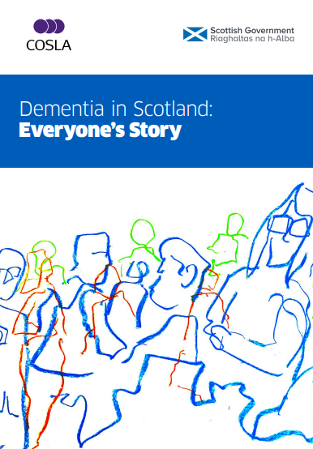
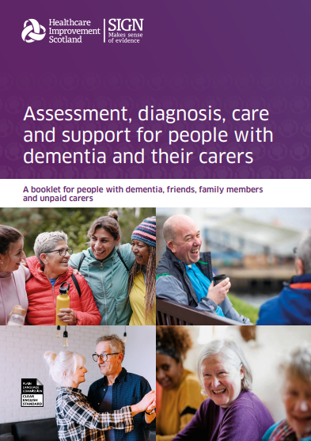
We are Scotland's dementia charity (alzscot.org) Alzheimer Scotland website. Lots of great resources and information about local support for people with dementia & their carers
NES Page on TURAS links to training for all levels of Promoting Excellence Framework Dementia |Turas | Learn(nhs.scot)
Connecting people, connecting support. Range of resources that can be utilised with patients/their families or they can be signposted to. connecting people, connecting support
National AHP webex series https://letstalkaboutdementia.wordpress.com/2019/03/28/national-ahp-dementia-webex-series-top-tips-for-working-with-stress-distress
Scottish Dementia Strategy Dementia in Scotland: Everyone's Story. Published in 2023 – 10 year strategy with 2-year delivery plans locally. Supporting documents -NewdementiastrategyforScotland:Everyone's Story -gov.scot(www.gov.scot)
Dementia SIGN guidelines: details recommendations based on current research for clinical care throughout someone's dementia journey from assessment, diagnosis to care and support - version for carers, friends, family and people with dementia – created by those with lived experience of dementia & their carers PAT168 Dementia patient booklet (sign.ac.uk)
Further Resources
Notes:
Stef SLIDES FOR INFORMATION post webinar don't read through this slide– just note these are other resources that may be of interest

Slide 18
Further supports to share with families & carers
Alzheimer Scotland - We are Scotland's dementia charity (alzscot.org)
  24hr Helpline: 0808 808 3000
Information and support - Dementia UK
  Dementia UK helpline 0800 888 6678 (Mon-Fri 9am-9pm, Sat-Sun 9am-5pm)
Connecting people, connecting support. Range of resources that can be utilised with patients/their families or they can be signposted to. connecting people, connecting support
Alzheimer Scotland have local community groups & other supports for people with dementia & carers
  Find support near you | Alzheimer Scotland (alzscot.org) or 01467 530516 to find out more about Aberdeenshire supports, 01224 644077 for City and 01343 552080 for Moray
Home – VSA: Carers support & other services
  Contact: 01224 212 021 or 01224 726670 Aberdeenshire carers.shire@vsa.org.uk
Quarriers – Carers Support
  City 01224 914036 aberdeencarers@quarriers.org.uk Moray 01343 556031 carersmoray@quarriers.org.uk
  Carers/families can speak to their GP or Community Mental Health Team/Dementia outreach team to be referred for further relevant support to meet their needs
Notes:
Stef
Lot of info on this slide – they will be sent out after the session, so don't need to note details down you'll have info there
There are a range of support services across Aberdeen, Aberdeenshire & Moray that provide groups and activities for people with dementia/their carers – Alzheimer Scotland is not just for Alzheimer disease but any type of dementia and has range of supports/groups - local programmes can call or search on their website for info.

Slide 19
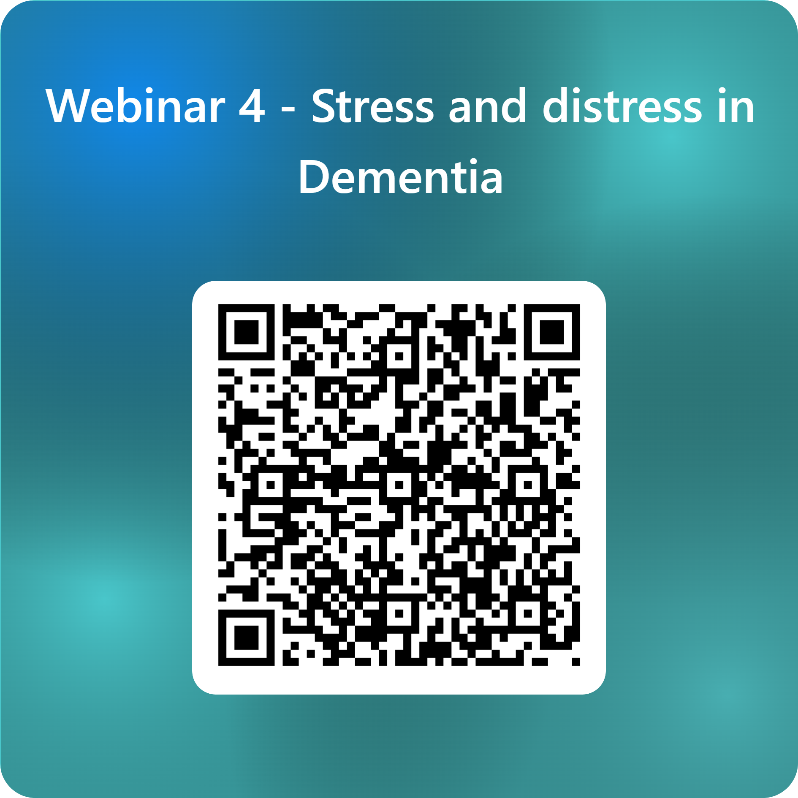
Evaluation
Notes:
Huge thanks to Alison and Stefanie for taking the time to present this webinar. Please take a few minutes to fill out the evaluation form whether you are watching live today or from the recording. Your feedback is really important. You can either scan the QR code or click the link in the chat.
Our next session is next week and that is on dementia inclusive environments. The last in the series is on 11th June and that will cover AHP rehabilitation for dementia. Thank you for attending today and we will hopefully see you at one of the upcoming sessions.

