Slide 1
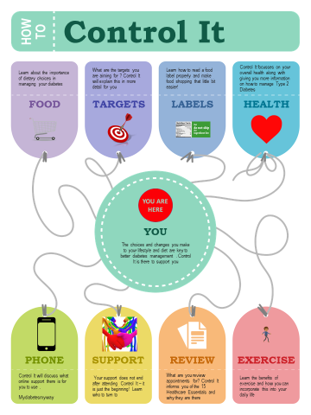
A Healthier Future –
Framework for the Prevention, Early Detection and Early Intervention of type 2 diabetes
The enhanced dietetic type 2 diabetes education and weight management services
are now being delivered Grampian wide. The new group education
Programme ‘Control It’ will replace conversation maps to offer a 3 hour
information session for patients newly diagnosed with type 2 diabetes, Click Here.
An enhanced Healthy Helpings programme is now being
delivered by dietitians and is available for patients to self-refer to. Follow
this link to the Healthy Weight website to find out more information
https://www.healthyweightgrampian.scot.nhs.uk/nhs-services/healthy-helpings/
The ‘Counterweight Plus’ programme provides input for patients requiring
advanced weight loss support.
In addition to the above, an initial small scale implementation of the Healthier Futures
Diabetes type 2 diabetes pathway has begun prior to wider roll out across Grampian. The pathway values education as important as health appointments and recognises the impact that Mental Health can have on the ability to self-manage. Options for patients include physical activity and health psychology interventions alongside dietetic services. This pathway aims to better support patients to self-manage their diabetes and to achieve improved health outcomes.
For further information please contact Emma Darling at emma.darling1@nhs.net.

