Slide 1
Acute Care at Home (AC@H) Lessons Learned
Katherine Karacaoglu (Public Health Researcher)
Denise Johnson (AC@H Team Leader)
08/05/2019

Slide 2
The AC@H Service
Previously ‘big ticket’ item
Based on ‘Hospital at Home’ model
A priority is to shift care from acute to community
Hospital admissions carry risks

Slide 3
The AC@H Service Model
First 6 months – Supported discharge pathway
End of input
Acute Care at Home care provision
(1-7 days)
Hospital Admission
Patient Acutely unwell in the community
Refer to AC@H when medically fit & appropriate
Hospital
Admission
Patient Discharged
Refer onwards e.g. to care management
Mid December onwards – Alternative to admission pathway
Patient unwell in the community
(otherwise admitted to hospital)
GP Refers to AC@H if appropriate

Slide 4
The AC@H Service – First 6 months
Team composition: Advanced Nurse Practitioner, Physiotherapist, Occupational Therapist, Pharmacy Technician x 2 (covering 0.5 post), Health Care Support Workers x 5
Note: Consultant Geriatrician challenges
In the first 6 months:
84 admissions to the service
Majority referred from GAU (67%)
Older adults with frailty requiring support following hospital discharge
Referral reasons: mobility concerns or other functional assessments
Care provided: reablement

Slide 5
AC@H Evaluation
This is a summary of the key findings from the first 6 months of service operation
Full report available now

Slide 6
Highlights – Key Findings

Slide 7
1) AC@H appears no less safe than usual care
Patient Location at 3 months | AC@H (N=82) | GAU (N=1028)
Deceased | 9 (11%) | 183 (17.8%)
At home/community | 65 (79%) | 786 (76.5%)
6.8% lower mortality rates
2.5% more people living at home
Mechanisms?
Rapid access to care and resources
Patient assessment at home
“Patients can get equipment faster through the OT rather than normally having to wait for the referral to go in. They get referred that morning, we go pick it up, the patient gets it that day”
“You see a very small snapshot of how somebody actually functionally manages when you see them in an acute setting as oppose to when you see them at home”

Slide 8
2) Patients reported high satisfaction with the service
Component | Mean Score
Satisfied | 80%
Well-coordinated | 78%
Recommend? | 82%
Team Confidence | 80%
Mechanisms?
Critical timing of care provision
“they just feel relieved, more secure, comfortable realising that they have not just been put out of hospital and abandoned.”
Continuity of Care (same as INCA)
“I was amazed at the amount of help I received. Each person knew exactly what they were going to do and did it all so cheerfully and willingly”
“They all like continuity, they like the same person going in, which is not always the best thing for us but they look forward to you coming”

Slide 9
3) Unpaid carers preferred their cared for person to be treated at home and that this reduced stress levels
Components | Mean Score
Less stressed? | 88%
Rather them at home? | 86%
Recommend? | 96%
Encouragement and support? | 96%
Mechanisms?
Reassurance & time for a break
Provided with support themselves?
“I could get my 3 hrs social visit and had no worries about my mum she was safe with him and I had a very relaxed time out shopping”

Slide 10
4) High staff satisfaction reported - particularly management style
The AC@H team were satisfied with their job - average score 73%
Management satisfaction
Transparent
“I think the senior team members are good team players they are, how they include you in everything”
Non-Hierarchical
“There is no like, you know, hierarchy or things like that. Everyone is treated as an equal”
Included in decision making
“any changes with the patient, we have a meeting and discuss the patient and we’re asked for feedback once we’ve seen the patient so I do feel like we are really included”

Slide 11
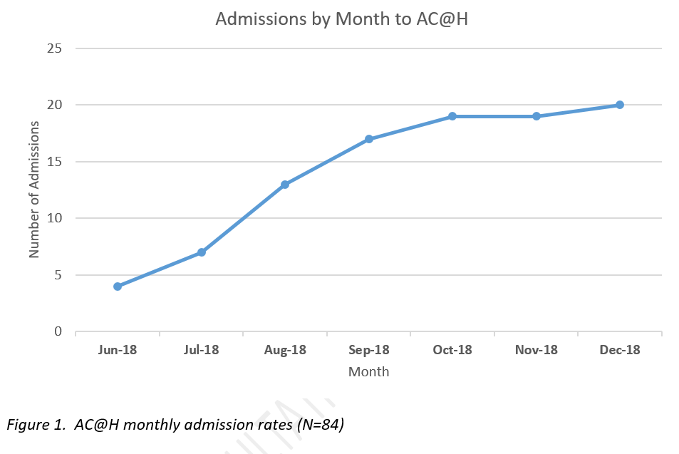
5) Training is necessary to upskill, but restricts service provision if carried out during working hours in a small team
On the assumption cannot recruit skilled APs..
Two options:
1) Prioritising upskill staff will limit service operation in the short to medium term
2) Prioritising limited upskilling of staff and consequently acuity of patients

Slide 12
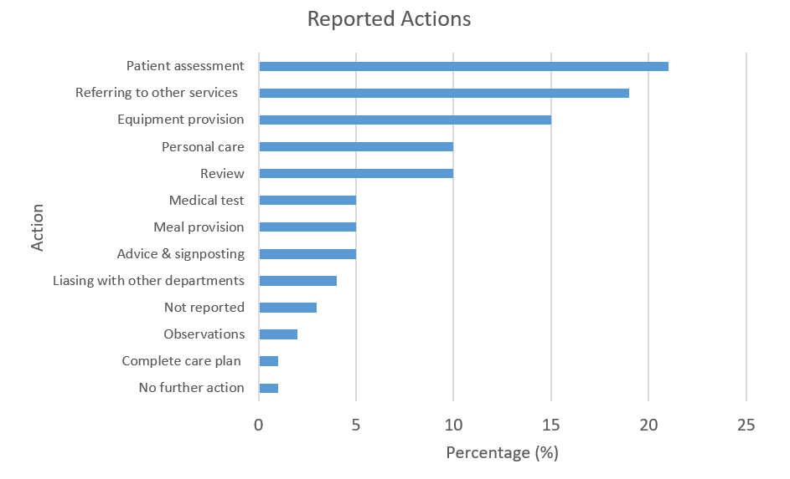
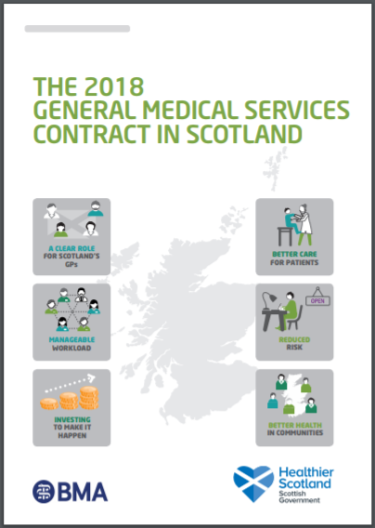
6) Considering localised recruitment challenges, theoretically-sound models of care delivery should be sought out and adapted to deliver locally to account for these challenges.
Currently: reablement support
For service development?
Other Health Professionals?
Advanced Practitioners
Require clinical oversight - supervisory model in both acute & community settings (Goldberg et al., 2016; Oliver, 2017)
Could a GP with special interests take on this role?

Slide 13
Important learning
Key mechanisms: care provision at a vulnerable time for patients, continuity of care, rapid access to resources & the ability to carry out assessments in patients’ own home.
Unpaid carers preferred for their cared for person to be treated at home rather than hospital.
Having a more inclusive management style appears to lead to high staff satisfaction.
Prioritisation between service operation and staff upskilling should be identified – both cannot progress simultaneously.
Considering localised recruitment challenges, theoretically-sound models of care delivery should be sought out and adapted to deliver locally to account for these challenges.

