Slide 2
Modernising Primary Care in Aberdeen City: A Baseline Evaluation
Kalonde Kasengele
Jacqueline Bell
Fiona Murray

Slide 3
Background
A medical practice in Aberdeen City started as a new entity on 1st October 2015, taking over the GMS contract for 10,000 local patients.
The need for this new practice was partly due to the recruitment crisis in general practice.
Permanent clinical staff included: 2 part-time salaried general practitioners (GPs), 3 advanced nurse practitioners (ANPs), 2 physician associates (PAs – a new role in primary care) and 2 pharmacists.
Notes:
In October 2015, a new medical practice was established using an innovative model of primary care. It introduced a wider multidisciplinary team: physician associates (PAs), advanced nurse practitioners (ANPs) and pharmacists working alongside GPs and practice nurses. This evaluation seeks to understand the effects of this new way of working on patients, staff and the wider healthcare systems.
PAs were new but ANPs were doing more of the GP work (diagnostic)

Slide 4
Aims and objectives
The purpose of the evaluation was to understand the effects of this new way of working on patients, staff, and interaction with wider healthcare systems. The main questions of interest from the practice’s perspective were to understand:
Patient perception/experience of care
Effectiveness of the appointment and triage system
Staff perspectives, are they engaged and do they have a vision for the practice?
Improvements that could be made
The impact, if any, that this new of working had on workload and referrals
Notes:
On the basis of this the objectives were to:
1. Describe patient awareness, experience & satisfaction with using the service
2. Describe staff/practitioner experience & satisfaction with providing the service
3. Describe patterns of service use – including practitioner workloads, in and out of hours, referral patterns, consultation/diagnostic changes, A&E attendances, emergency admissions
4. Identify ideas for improvement that can be implemented in an action cycle.

Slide 5
Methods
A mixed-methods approach was used, comprising:
focus group sessions with different staff groups and for patients with long-term conditions;
a patient survey (Viewpoint machine or paper-based);
data from the practice IT systems (staff workload).
Data collection period was between August and October 2016

Slide 6
Findings

Slide 7
Patient experience of care
Notes:
The majority of respondents were satisfied with the care they received at New Dyce, 80% rating it as good or very good
Most patients reported having a good experience in their consultation including: receiving clear explanations of their condition and treatment (72%); feeling involved in decisions about their care (69%); having sufficient time (60%); and confident in the knowledge shown by professionals (75%) and the advice or treatment provided (66%). Moreover, 83% of respondents felt that their issue had been dealt with by the right person, and this was similar across the professional groups seen (GPs, ANP, PAs, pharmacists). Those who were not sure who they had seen were the least likely to respond positively (only 46%).

Slide 8
Staff perspectives on the new model
Overall the attitude was very positive with a forward looking approach
Staff stated that first few months of the transition had been difficult for patients, largely because of poor understanding of the ANP and PA roles.
However, there was a general consensus that patients were becoming more accepting of this new workforce.
Increasingly, patients (particularly regular attendees) were calling in requesting to see the same ANP/PA that had previously attended to them.
Capacity to prescribe was seen as a major advantage
Notes:
The attitude of staff in each group to the new way of working was very positive and there was a great willingness to find opportunities to improve and develop the service.
They also agreed that the first few months had been very difficult but that patients were now more accepting and the example given was that…
The fact that ANPs can prescribe was seen as a considerable advantage because it allows them to work more independently and take on additional responsibilities. One staff member described them as being like “another doctor” because they could just “get on with the work”. PAs were seen as being good at what they do (particularly examination skills and history taking) but there was general agreement that they were restricted because they could not prescribe, and consequently almost always have to consult the duty doctor. This was a source of frustration to patients, PAs and other staff members as it often led to delays in consultations.

Slide 9
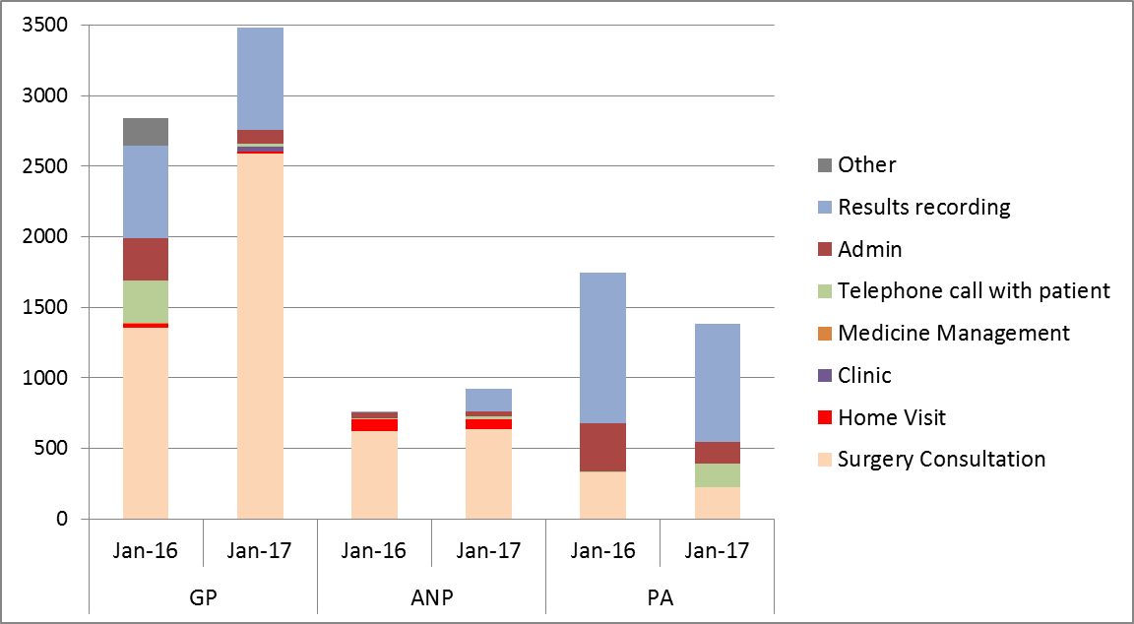
Comparing workload by professional group and activity (numbers)
Notes:
GPs do the majority of the patient contacts (consultations and telephone calls) the number and proportion of GP activity spent on patient contact has increased substantially over the year - 35% at the start of 2016 to 60% in 2017
In January 2017 GPs did 74% (2,593) of the total consultations. In comparison the ANPs did 10% and the PAs, 4%. Telephone calls and admin both decrease.
The ANPs did the majority of home visits, 76 (84%), with the remainder conducted by GPs. And also took on some results recording duties.
The PAs had the smallest share of consultations and did more administration than the other two groups. In 2017 they conducted 80% of the telephone calls with patients.
The monthly number of patient contacts made in total (by GPs, ANPs and PAs) increased from 3,930 in January 2016 to 5,362 in January 2017, despite the staff resource remaining fairly constant.

Slide 10
Identified areas for development
Triage
Patient-facing systems
Training for receptionists
Reception area
Communication with patients
Review
Notes:
Triage: there were different views on how patients were allocated to clinicians – this needed to become more transparent – since the review the practice are trying to introduce a combination of guidelines for reception/administration staff and a GP phone call triage system. One advantage of using GPs for triage would be to increase the confidence of patients in their allocation to other professionals.
Improve patient-facing systems: this included modifications to the automatic check in and the phone system should be checked regularly to ensure callers can get through in a reasonable length of time.
Training for receptionists: Staff at reception may benefit from further training in dealing with people when under pressure. Customer/patient centred training would help make the front facing as welcoming and professional as possible.
Reception area: Confidentiality was a concern and it was suggested that a monitor with health information/TV/ music be introduced to mask conversations at the front desk.
Communication with patients: To continue to improve patient understanding of the new way of working further information could be given. For example, by using signage in the practice to explain the different clinical roles (including photographs) and/or circulating a newsletter to introduce new staff/explain roles.
Review workloads: it may be useful for all staff to meet regularly to consider workload breakdowns and discuss whether these reflect the optimum use of time.

Slide 11
“I would like to see notices on the walls - describing the types of staff you can see and what you would recommend we see them for. This would give me more confidence.”
“How does a receptionist decide if it is a doctor or NP you see. I would like to know if they are medically knowledgeable to decide.”
“Very lucky to have the level of care provided. It is probably the future of GP practice and provision; don't see why other health care providers shouldn't take up other treatments etc.”

Slide 12
Conclusion and wider implications
The response has been generally positive, with high levels of satisfaction from both patients and staff. This suggests that things are moving in the right direction after a very challenging beginning.
Using ANPs and PAs to supplement GPs may have potential in some contexts and warrants further investigation

Slide 13
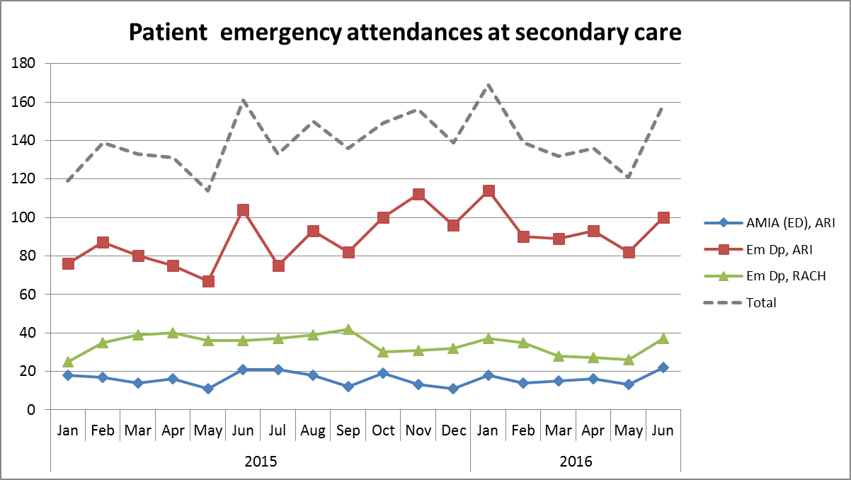

Slide 14
