Slide 1
West unscheduled care test of change Evaluation
Dr Calum Leask
Research & Evaluation Manager
Heather Tennant
Transformation Programme Manager

Slide 2
1
Less people
Less disease
More people
More disease
2
3
GPs leaving
Primary care pressure
TEST
NEW
IDEAS

Slide 3
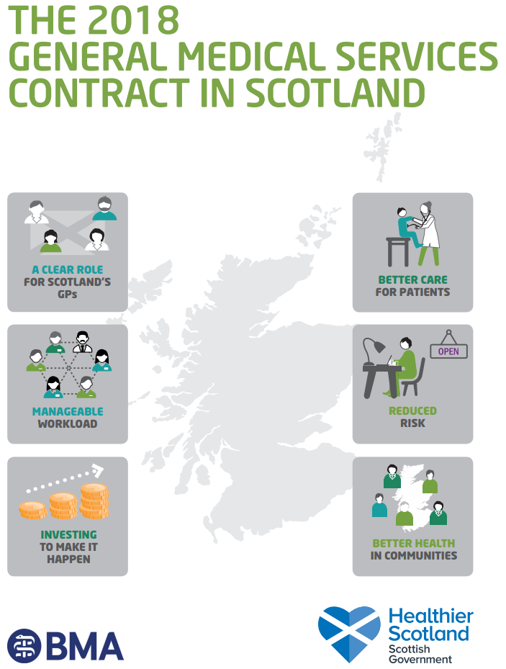
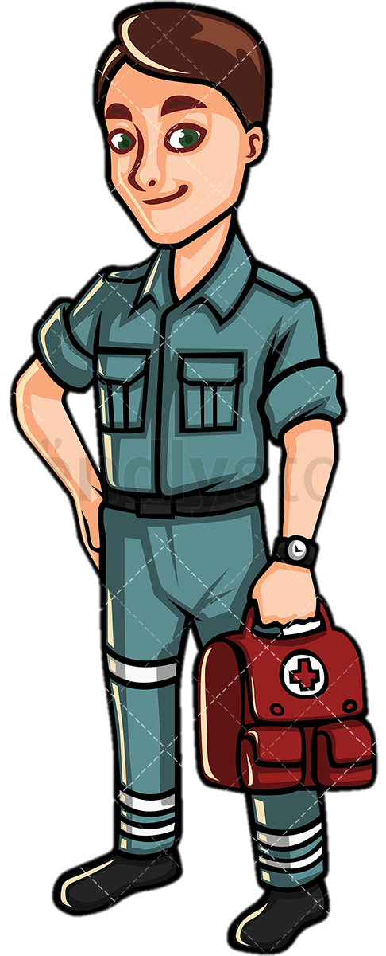
1
2
PRIORITY: URGENT CARE SERVICES
Advanced Practitioners
Deliver unscheduled home visits
- Successful in Inverclyde
- 60% less GP home visits
“Will this work in Aberdeen?”

Slide 4
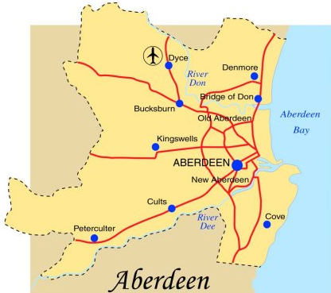
West visits service
Afternoon home visits
West Locality
Advanced Nurse Practitioner + driver

Slide 5
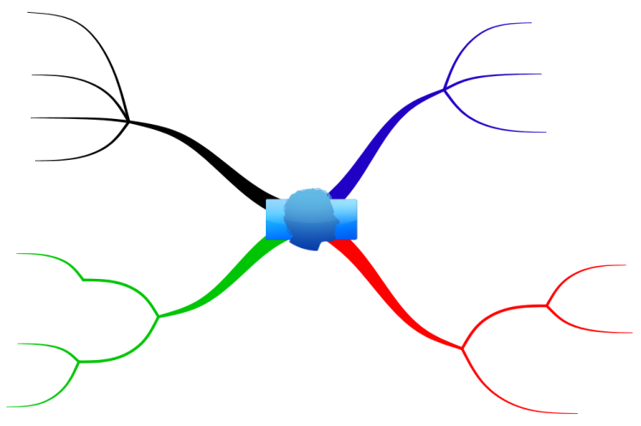
Data collection methods
Patient experience
Satisfaction questionnaire
Service data
Referrals (by number & practice)
Outcome of visit
Patient-facing time
GP / ANP experience
Perceived
Benefits
Implementation
Considerations
Perceived
Drawbacks
Future
Recommendations

Slide 6
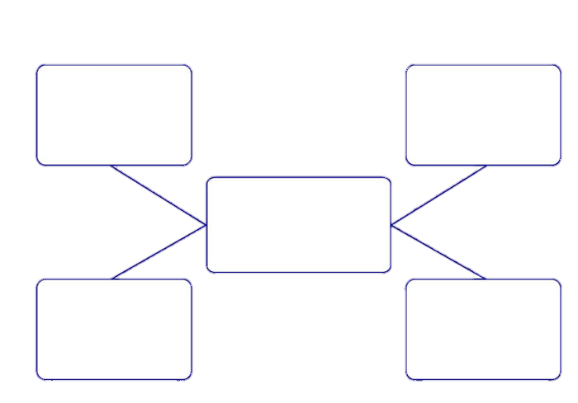
Visits overview (first 6 months)
Vomiting
Abdominal
Pain
Referrals = 241
Common
Referral
Reasons
Accepted = 239
Rejected = 2
Chest
Infections
Falls

Slide 7
GP Practice Usage
Month of most referrals
April 2018 (52)
Most frequent referrers
Great Western Road (68)
Least frequent referrers
Camphill (7)
Adjusting for practice population
Most frequent referrers
Hamilton (7.2 per 1000 patients)
Least frequent referrers
Peterculter (0.3 per 1000 patients)

Slide 8
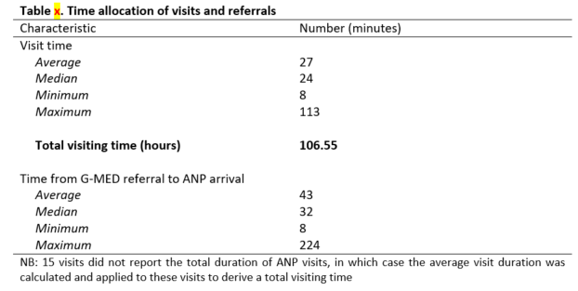
Time allocation of referrals and visits
Total patient-facing time = 106.55
Associated cost saving of GP time = £6259.81
Total travel time for home visits = 2390 mins
Associated cost saving of GP time = £2340.21
Total cost saving of GP time = £8600.02
Excludes avoided admissions
Excludes improved patient flow
<actual saving will be higher>

Slide 9
Outcomes of visits
Medication & WSG
(107 cases)
Most Common Outcomes for Visits
Self-care advice
(47 cases)
Hospital admission
(28 cases)

Slide 10
Patient experience
“The home visit was excellent – the nurse was very good and patient with me. I wish we could get someone like her all the time” (Responder 3).

Slide 11
GP Experience

Slide 13
They’re incredible [ANP]. So if I was unwell I might be looking to see an ANP rather than a GP … they’re good all round practitioners and they’re good at assessing things” (GP, Practice 5).

Slide 14
“My concern is more in terms of what happens in the future … and that’s to do with my experience of over a couple of decades of fantastic sounding pilot projects that are pump-primed only to not recur … so I have to be allowed a certain about of cynicism about that” (GP, Practice 6).

Slide 15
“It was a culture change, you know? I’ve been in general practice for way too long now and that’s always been the case. Years and years ago in another practice a nurse practitioner was out, and then gradually they came in and the GPs were like “okay, this works, this is great”, so the role expanded … and gradually the confidence builds” (Practice Manager, Practice 3).

Slide 16
“Might the service in the future look like a team that had a selection of different professionals … the ability for a patient to be requesting directly rather than always having to go through the GP to get things going, that would be a huge advantage” (GP, Practice 6).

Slide 17
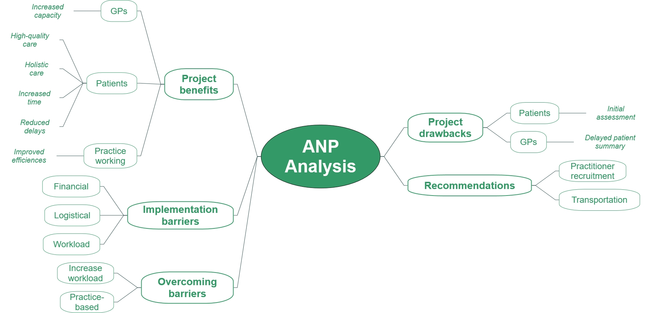

Slide 18
“We’ve got everything in the boot. If we think someone needs an ECG we can do it. We can do bloods as well, that’s things that you’d need an appointment with a phlebotomist maybe 2/3 days down the line … so you’re helping other services within the practice as well” (ANP 3).
“The way we had to do our shift pattern was so we didn’t lose our enhancements … if we just did the day time we would be losing quite a lot of money which, for us, you think well what’s the benefit to us, because we’re providing you [the GPs] with a really really good service but we’re actually losing money” (ANP 2).

Slide 19
Scaling the model
Phase 1
Assessing feasibility (does this project work?)
Phase 2 (Torry)
Testing service capacity (current rejection rate of only 0.8%)
Phase 3
Distributed scaling model (taking this current model and testing in another area)
Status: complete
Status: live
Status: in development

Slide 20
THANK
YOU
QUESTIONS?
Dr Calum Leask
Research & Evaluation Manager
West unscheduled care test of change
Evaluation / scaling update
E: calum.leask@nhs.net
Heather Tennant
Transformation Programme Manager
E: heather.tennant@nhs.net

