Slide 1
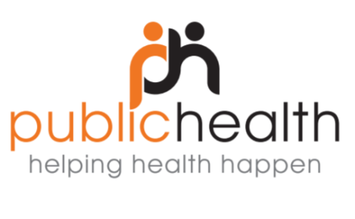
What are the features of effective collaboration between public health and data scientists? Evaluation of a hackathon addressing society’s relationship with alcohol
Emma Davies, Fiona Murray, Jacqueline Bell, Tara Shivaji (NHS Grampian)
Wayne Gault (Aberdeenshire Alcohol and Drug Partnership)
Ian Watt (Code The City)
Notes:
Introductions
We are here to talk about our evaluation of a public health hackathon.
<CLICK>

Slide 2
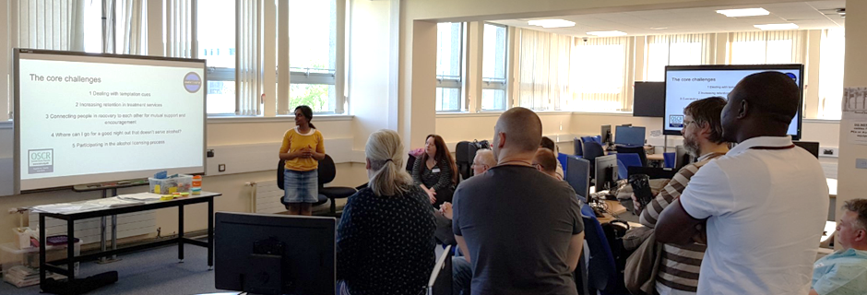
What do we mean by a ‘hack’?
Finding tech-based solutions
Using freely available data
Notes:
Although hackathons are becoming increasingly popular, there is not a good general awareness of what they are and what they are used for. Hacking in this context isn’t anything illegal. It isn’t about sabotaging the space station or worming your way into the Pentagon. Hacking in this context is about breaking down problems and then finding tech and marketing-based solutions using freely available data – rather like the app that tells you when your next bus is due.

Slide 3
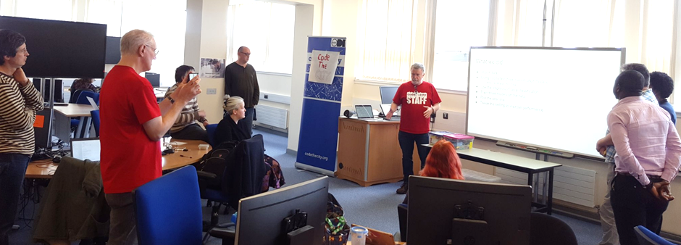
What is a hackathon? Case study: society’s relationship with alcohol
Intensive
Multidisciplinary – ‘hackers’ and subject area experts
Innovative
Notes:
A hackathon is when participants from various backgrounds come together to work collaboratively and ‘hack’ a problem over a short period of time, typically 2 days. This was the case in May 2018, when Code the City and NHSG Public Health held a hackathon on addressing society’s relationship with alcohol. Code the City is a hacking initiative in Aberdeen led by a group of experienced enthusiastic volunteers. Participants included those with experience in software design and development, marketing and subject area experts, for example, people in recovery from alcohol addiction and people working in public health and relevant third sector organisations. It wasn’t expected that there would be a finished product at the end of a hackathon, but the hope was that prototypes would be developed which could be possibly taken up and developed by a sponsor. At the end of this weekend, three prototypes had been developed by three groups each to address a different aspect of society’s relationship with alcohol. [possibly put these on a new slide with graphics to illustrate?]These were around: using artificial Intelligence to identify irresponsibly labelled alcohol products; promoting alcohol-free social spaces through Mocktail Awards; and connecting recovery groups and communities across Scotland. More information on these can be found on the CTC website.

Slide 4
How do we best use a hackathon?
Limited available literature
Public health problems are complex
Aim: To identify features of an effective public health hackathon
Notes:
There feels like there is great potential for using the concept of a hackathon to find innovative solutions to public health problems. The available literature describes how to deliver a hackathon and the general benefits of such events, which have also previously been used to look at e.g. promoting tourism and access to sports facilities . However, we know that public health problems are particularly complex and multi-faceted, without clear answers. There’s limited information about how to use a hackathon to address these types of problems.
We, therefore, used the hackathon on alcohol as a case study to assess and identify features of an effective public health hackathon.

Slide 5
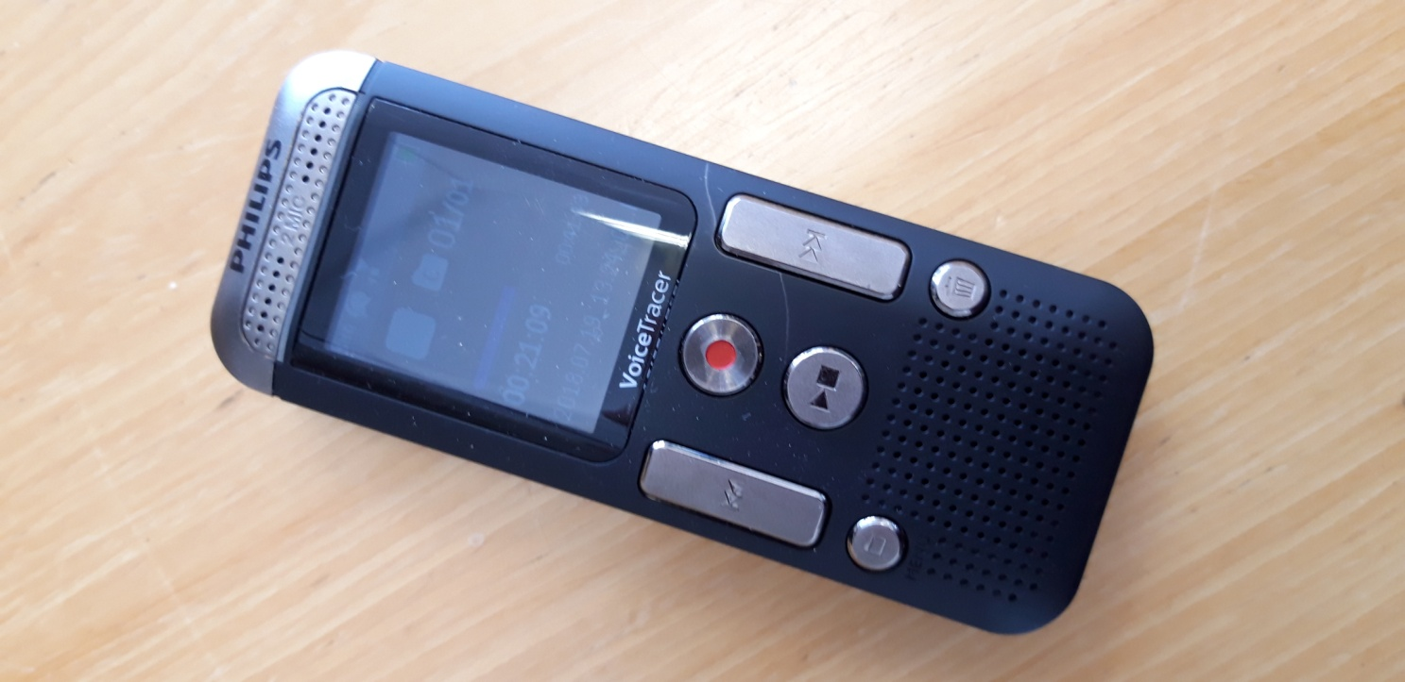
Methods
Electronic pre- and post-event questionnaires
Semi-structured interviews
Thematic analysis
Notes:
Questionnaires before and after the hackathon were distributed electronically to participants, asking about their expectations, their motivations in participating and their experiences during the event.
We conducted semi-structured interviews with the public health substance misuse lead; Aberdeenshire Alcohol and Drug Partnership’s team lead and a director of Code the City who all helped to organise the event and participated in it. Interviews were transcribed and analysed thematically to identify the key features of effective collaboration.
.....<CLICK>

Slide 6
Results: Features of effective hackathon
Themes
Preparation – info, attendance
People – numbers, skill mix
Working together – aim, addressing challenges, facilitation
Outcomes - expectations met, development potential
Follow up - outputs, evaluation
Notes:
Here is a very brief overview of our results. Overall, 5 broad themes emerged:
Firstly, good preparation: This includes the right amount of pre-event information and using methods to maximise attendance and mix.
Secondly, the people attending: There should be enough people to allow sufficient progress with a mixture of skill sets and experience
Thirdly, good working relationships: there needs to be a mutual understanding of the aim; processes in place to allow participants an ability to get the best out of each other and also to work through any problems together. This is helped by effective facilitation that keeps things moving but is ‘light touch’– after all one of the attractions of a hackathon is that it’s quite unconventional and free-flowing.
In terms of outcomes, that the expected benefits for individuals are achieved and the prototypes that are created have potential for further development
And finally, follow-up. This is about having a recognised process in place to feedback about the hackathon, follow-up on any links that were made and to support the development of the prototypes.
The key to effectiveness was being able to work together in a spirit of openness
.....<CLICK>

Slide 7
Working together: benefits
“They [the prototypes] were actually much more human-centric and much less technology-centric and they [the participants] were actually thinking about what it would be like to be that person in recovery.” (P1)
“[we were] wowed at the ideas of the marketing people. It [the potential solution] was put so simply and so clearly that you just think ‘ah, that’s a really good understanding of our problem and a really simple way that we could potentially solve that problem’.” (P3)
Notes:
When this happened, benefits were seen for both the hackers and the subject area experts.** Collaborating with those with lived experience allowed specific real-life problems to be identified, for instance the lack of non-alcoholic choices in bars* and the fact that there is no one point of contact for recovery services. Having people with lived experience also seems to have altered the shape of the outputs away from the usual tech-based solutions of other hackathons. As one participant put it They were actually much more human-centric and much less technology-centric and they were actually thinking about what it would be like to be that person in recovery.
Subject area experts benefited from the ability to sense-check ideas, hear fresh perspectives on an issue, and tap into other people’s experience. Another participant said that they were…wowed at the ideas of the marketing people. It was put so simply and so clearly that you just think ‘ah, that’s a really good understanding of our problem and a really simple way that we could potentially solve that problem.
**Making links at the hackathon was also thought useful for developing opportunities for longer term collaboration.
.....<CLICK>

Slide 8
Working together: using talents
“It was so valuable to have people with lived experience there and participating, but how [do] you encourage that participation and help it along in that setting…” (P3)
“People like us in public health sometimes need the sense-check of someone saying ‘That’s ridiculous’.”(P2)
Notes:
However, there was also acknowledgement that working together well isn’t always easy. As one participant put it, The “working styles of some hackers and subject experts are quite different”. **Sometimes it was difficult to articulate ideas to each other, * for instance jargon being used that wasn’t familiar to everyone. Hackers tended to think their expertise had been made use of rather more than the subject area experts did, suggesting that there’s some room for improvement in ensuring everyone is able to contribute fully. This was also highlighted by a participant who said that It was so valuable to have people with lived experience there and participating, but how [do] you encourage that participation and help it along in that setting…
....<CLICK>

Slide 9
Working together: challenges
Hobby/ something to be enjoyed
Need to be open-minded
Continuity of group membership
Emotional and personal topic
Wishing to see very specific issues
Cross-pollination of ideas
Notes:
There’s something of a ‘yin and yang’ to this sort of working together. A key challenge was keeping the right balance. For some participants hackathons are a hobby and something to be enjoyed at their own pace.* For others the topic may be an emotional and personal one, and they will come along with a desire to be productive. There’s also a need to be open-minded to possible solutions – this is the nature of a hackathon, but some participants will want to see very specific issues addressed. Participants at this hackathon tended to go between different groups, which was useful for gaining fresh ideas and perspectives but there was a need for some core members to remain in each group to make progress.
**(pause) We appreciate that our findings are based on one case study and we are unable to say for sure to what extent they are context-dependent…That said .....<CLICK>

Slide 10
Suggested ways forward
Mutual understanding
aim and process prior to the event
group’s skill set and experience
Group facilitators
Use of shared tools and materials
Further evaluation of public health hackathons
Notes:
…we think hackathons provide a new methodology and we’ve some suggested ways forward for their use in public health.
We recommend that there should be mechanisms in place to ensure mutual understanding of the aim and process before the hackathon and to minimise false expectations.
Also there needs to be mutual understanding of the group’s skill set and experiences to help groups get the best out of each other. * Group facilitators might be helpful for groups in overcoming challenges and making progress. The use of shared tools and materials could help participants from different backgrounds to understand each other’s perspective and language, for example, in supporting the visualisation and make-up of a strategy.
Finally, we would recommend that further public health hackathons are also evaluated
.....<CLICK>

Slide 11
Conclusion
Can help address intractable public health problems
Provide a methodological advance
Potential for broad public health application
The findings provide insight into fostering collaboration
Notes:
So, in conclusion, we believe hackathons can help break down intractable public health problems and provide a methodological advance with potential for broad public health application. The findings of this study provide insight into how to foster collaboration between public health and data scientists in this context.
<CLICK>

Slide 12
“...opens folks minds to the potential” (P2)
Notes:
...and in the words of one participant ...opens folks minds
THANK YOU

Slide 13
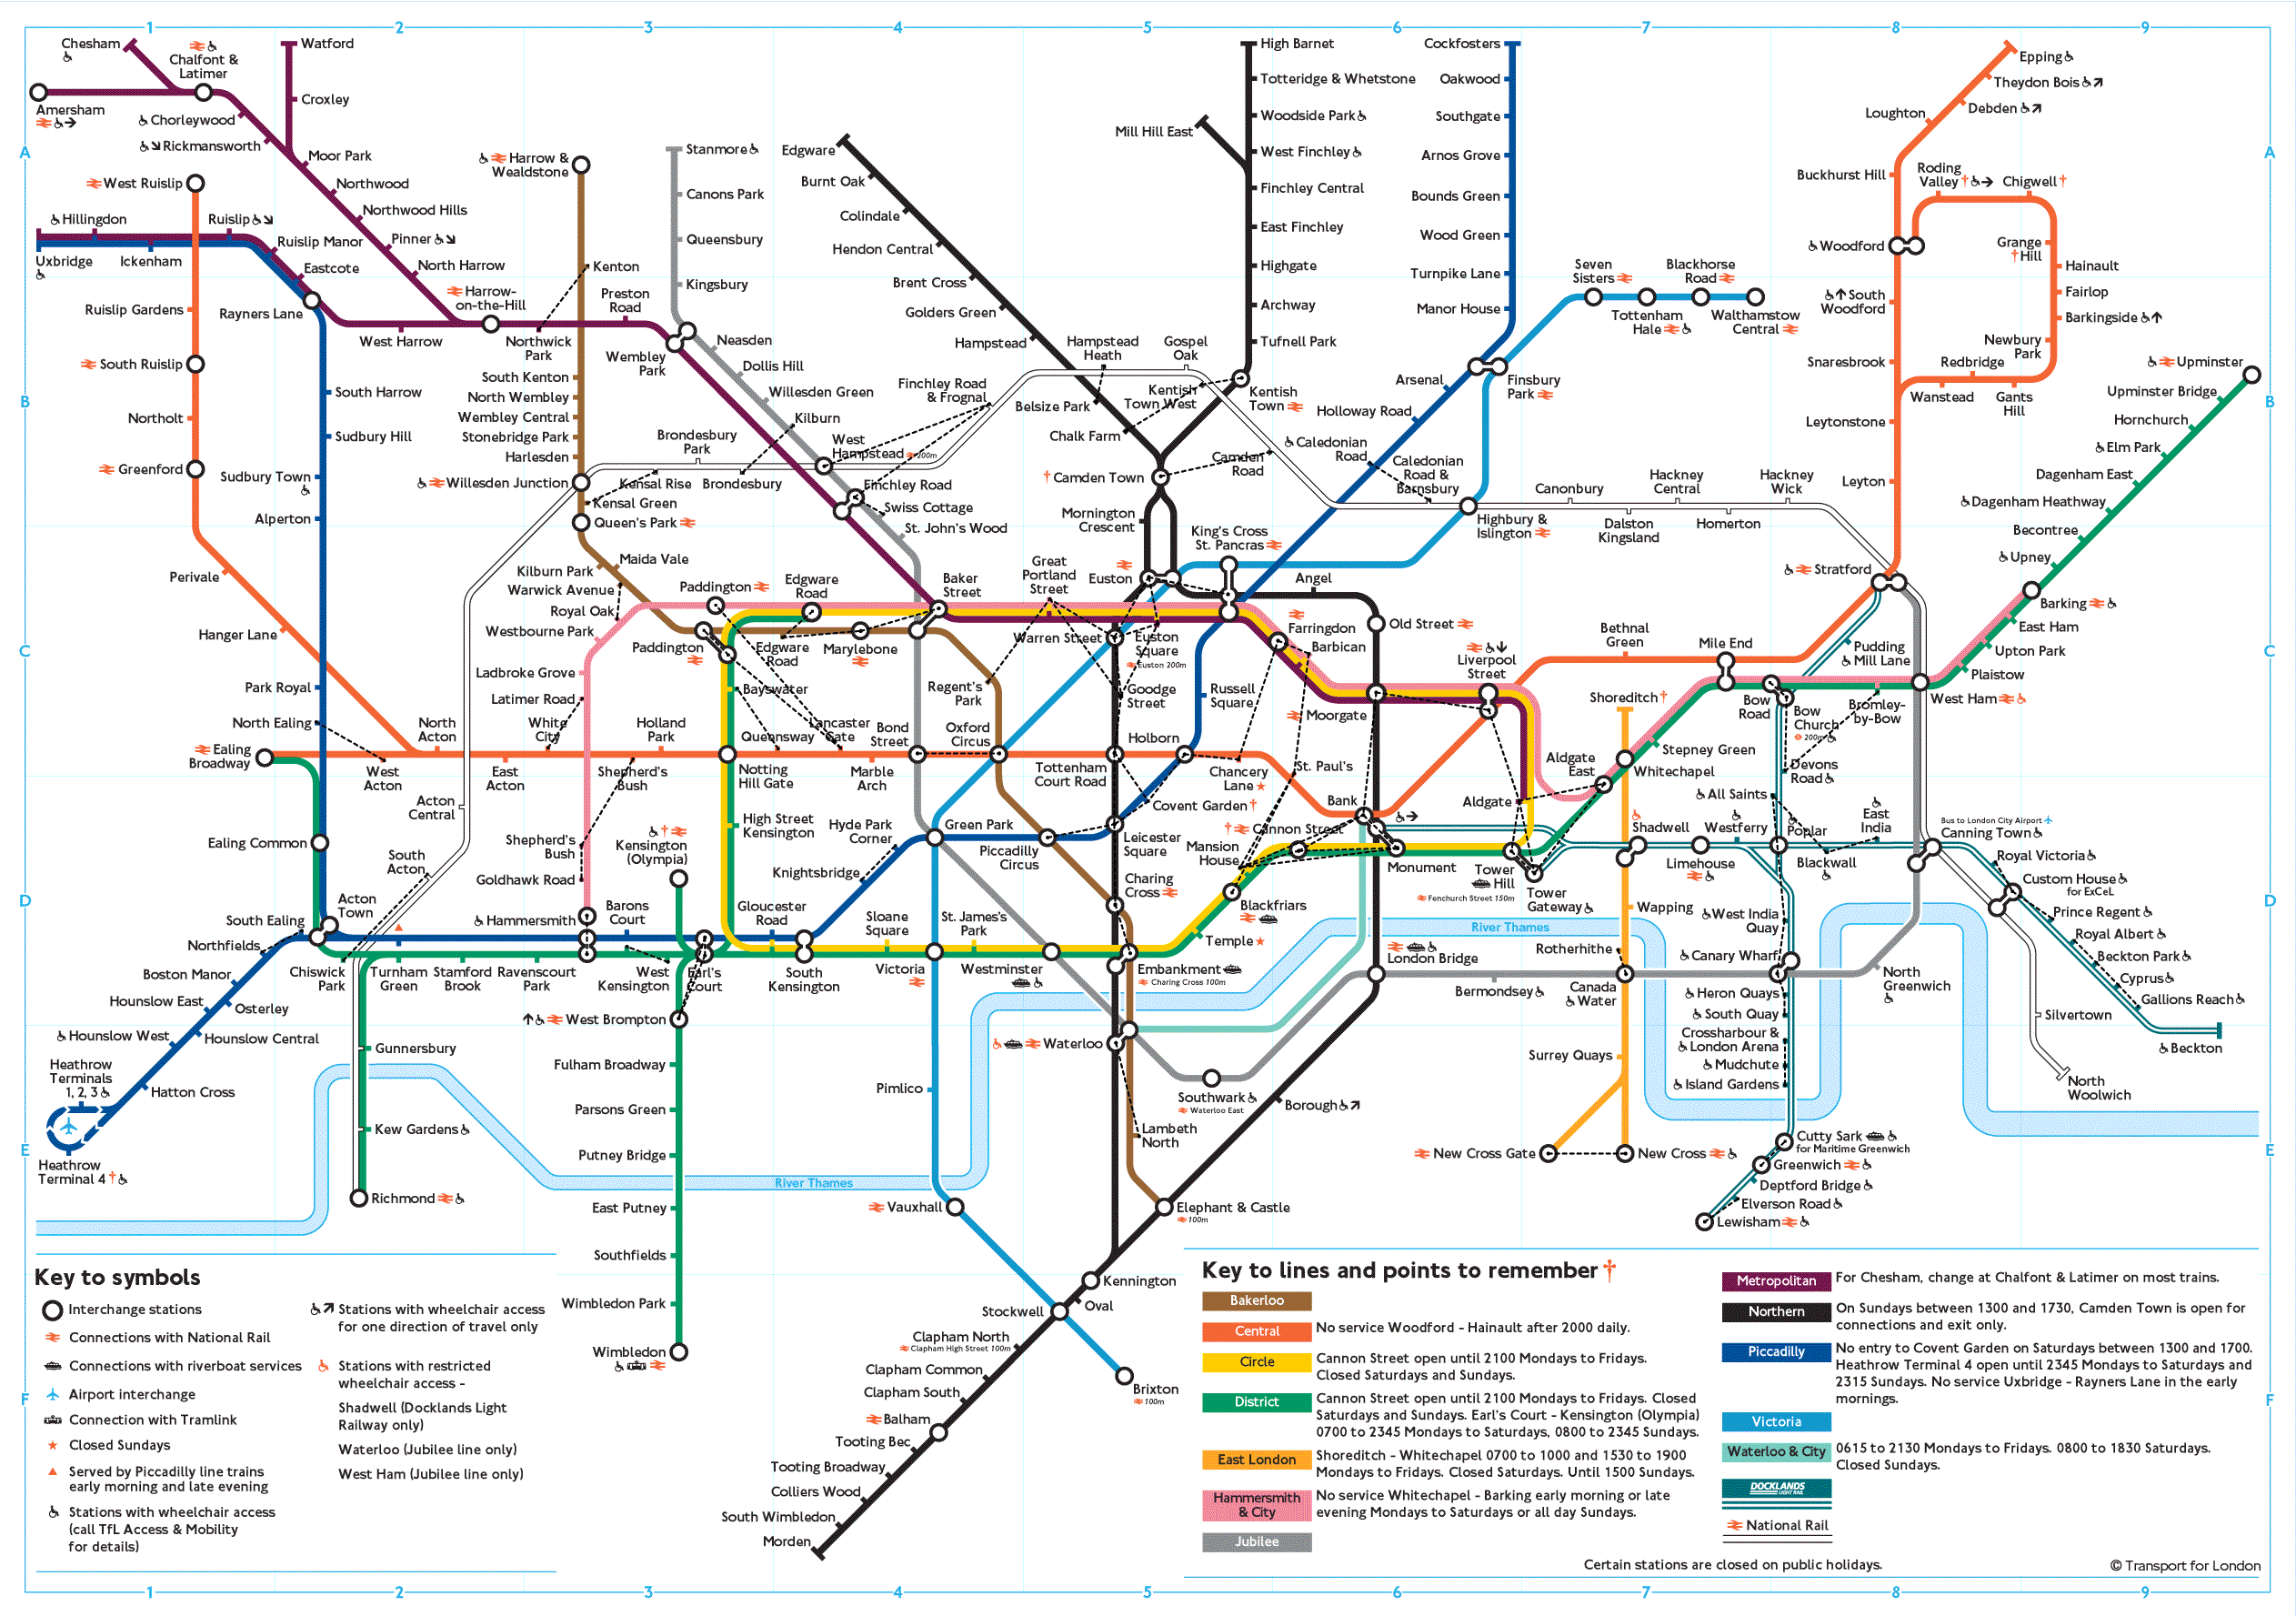
Notes:
Accessing services
Non-alcoholic drinks – mocktail awards
Irresponsibly or misleadingly-labelled drinks
Follow-up:
Alcohol Concern in England has expressed interest and are in contact with the Code the City Team possibly creating a ‘bot to scour the internet for new can designs and flag up where these might be perceived as non-alcoholic when they are in fact the opposite and make it easier to report designs transgressing labelling regulations to the appropriate authorities – The Portman Group].
Also, NHS Grampian Head of Innovation plans to include ‘Identifying high risk of unscheduled admission among people with alcohol and drug problems using AI’ in a bid for national innovations monies. This idea came directly from learning at the hackathon.

