Slide 1
Evaluation of an Elderly Care Nurse role
Kincorth & Cove Medical Practice
Jacqueline Bell
Fiona Murray
November 2017

Slide 2
Stages of Evaluation
Data Gathering Methods
Interpret, Report & Recommend
Purpose & Scope
Plan & Design
Selecting Indicators
Data Analysis

Slide 3
Aims : to provide evidence on the effectiveness of the ECN to help the practice decide whether to continue the role
Sustainability – Quality – Bed days in hospital
Objectives
to understand changes in workload/practice by role
to understand the effect on other services and providers
to assess the satisfaction of patients and their families
to identify any aspects for improvement

Slide 4
Stages of Evaluation
Data Gathering Methods
Interpret, Report & Recommend
Purpose & Scope
Plan & Design
Selecting Indicators
Data Analysis

Slide 5
Indicators
Workload of GPs, nurses
Numbers of OOH/secondary care contacts
Number of referrals
Patient satisfaction
Data collection & analysis
Activity data from Vision (GP IT system)
Referral data from Vision and Skystore
Secondary care data from Trakcare and PMS
A small patient telephone survey

Slide 6
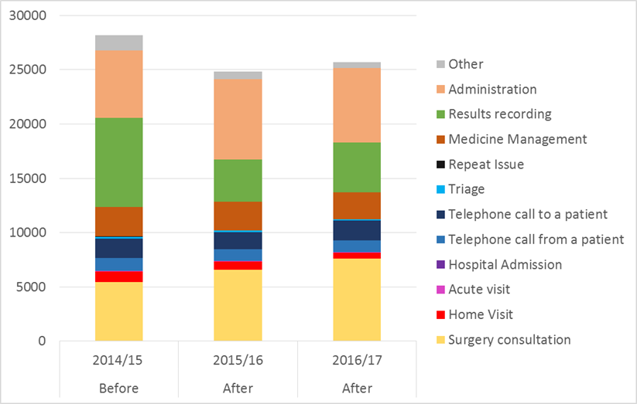
Findings 1: GP workloads

Slide 7
‘When you phone to speak to a doctor, it’s a locum or duty doctor and they don’t know you. She knows. That personal knowledge. Going back to 40/50 years ago when you only had the one doctor. [ECN name] picks up on it pretty quickly. I don’t need to go over things with her ‘cos she knows it!’
‘Give us more [ECN name]. I think it’s a fantastic improvement.’
‘And sometimes she’ll give me into trouble for nae callin’ her earlier. I got me knuckles rapped.’
‘I’m happy to see anyone, so long as they’re qualified’

Slide 8
‘I think she’s absolutely outstanding. She’s as good as a GP. It’s better seeing her, you get a better talk with her, than you do with the doctor. You always feel with the doctor you’ve got ten minutes then get oot. She never says she’s got 10 minutes. She never says “I have to go”- never heard her say it yet.’
‘She simplifies things down. It’s not all medical terms. It’s brought into layman’s terms.’
‘She’s up to speed with everything’
‘My friends couldn’t believe I’d had her visit 3 or 4 times. Well, they’re not with my practice, Kincorth, and they have nothing like this service. I’m very happy with it.’
[‘Is there time when you’d rather have seen a GP?’] ‘No. I’d rather see her.’

Slide 9
Kincorth A&E Attendances among over-65s, April 2014-January 2017

Slide 10
Emergency admission rates for over-65s in Kincorth practice, Feb. 2013-June 2017 (SMR)

Slide 11
Discussion 1 – Findings
Sustainability
Quality
Secondary care
Carer support
Future development
Extending into other practices

Slide 12
Discussion 2 – Limitations
Not there at the start - not able to collect everything needed + no observer effect
Disentangling effects - role/person - influencers on trends
Data quality

Slide 13
Discussion 3 – Lessons learnt
Encourage consideration of evaluation early
Move faster!
Share/ disseminate

